Slide 1
Environmental Pollution
Chloe Schaefer
Beth Himburg
Sustainable Urbanism and International Perspective: China
Spring 2013
University of Cincinnati
`

Slide 2
Environmental Justice
Everyone has a right to clean air, water, and no one has the right to degrade or destroy the environment
Pursuit of equal justice and protection under the law for all environmental statutes and regulations without discrimination

Slide 3
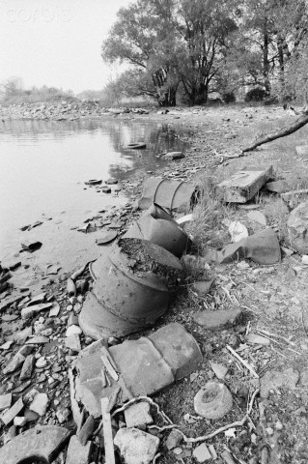
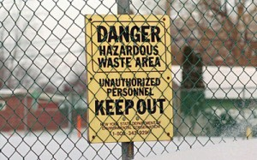
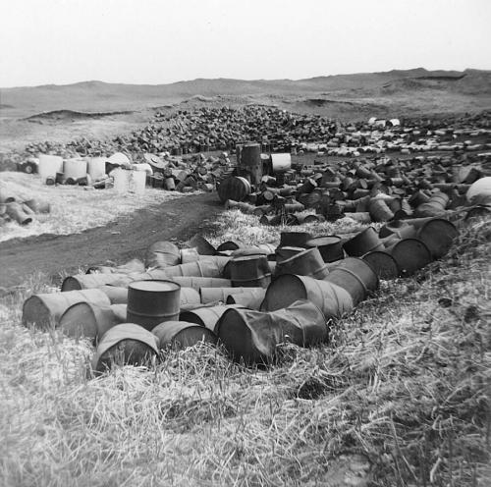
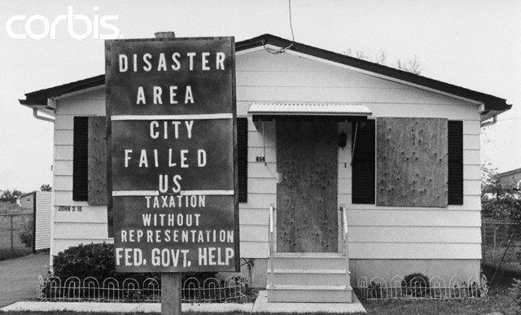
Pollution
Love Canal
  NY, 1950s

Slide 4
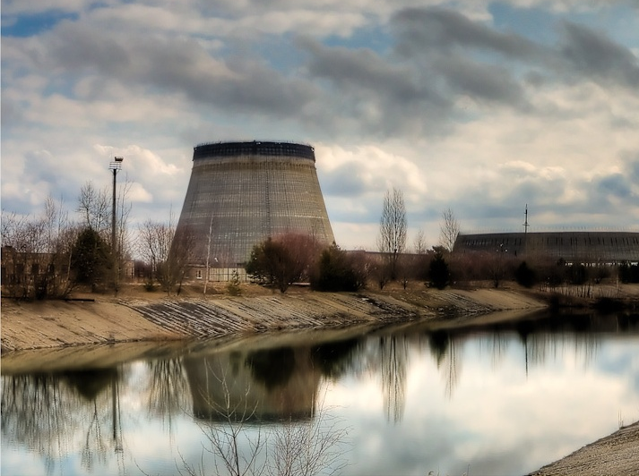
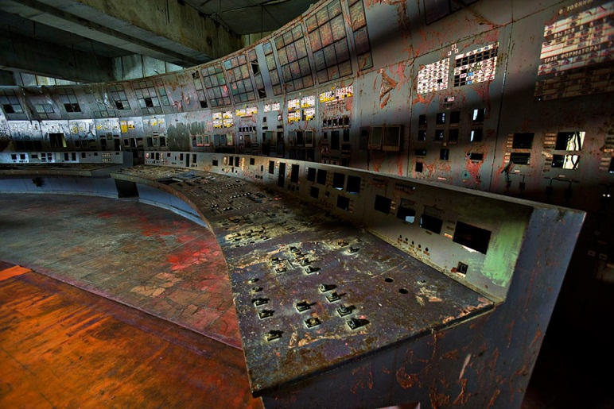
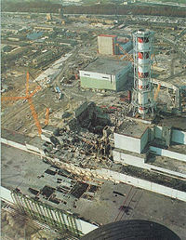
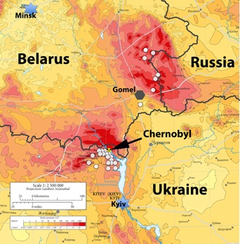
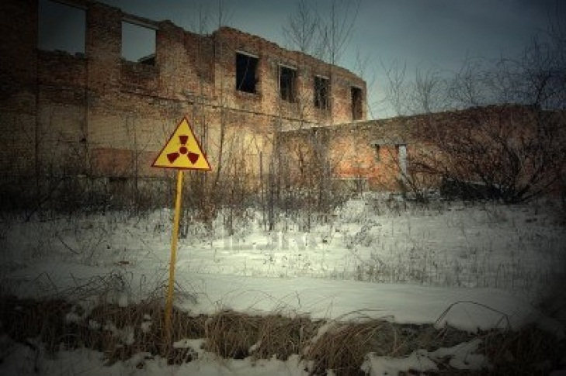
Pollution continued
Chernobyl
  Ukraine, 1986

Slide 5
Consequences of Pollution
Pollution creates risks to human health such as cancer, asthma, birth defects, endocrine disruption, sickness and sometimes death
Pollution also poses a threat to environmental health by infecting ecosystems with chemicals (from industrial or air pollution) that disrupt the natural flow of nutrients through the system
  This can lead to algal blooms in waterways, which creates a cascade effect to the health of all organisms in the ecosystem, or the total death of all organisms in an area

Slide 6


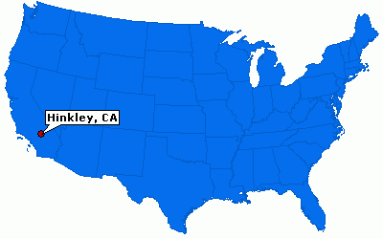
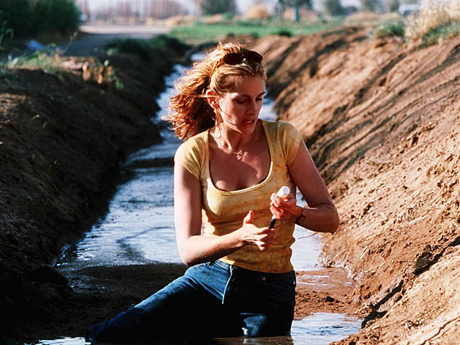
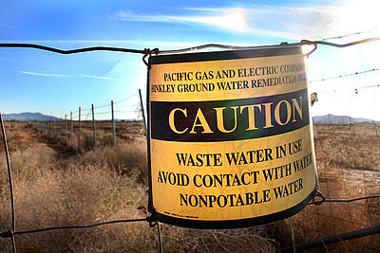
Erin Brockovich
Hinkley, CA, 1993
Groundwater contaminated with hexavalent chromium

Slide 7

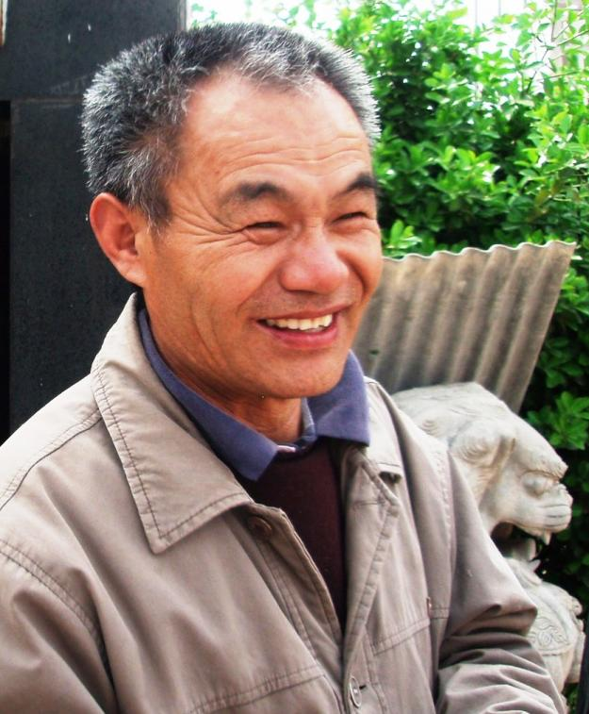
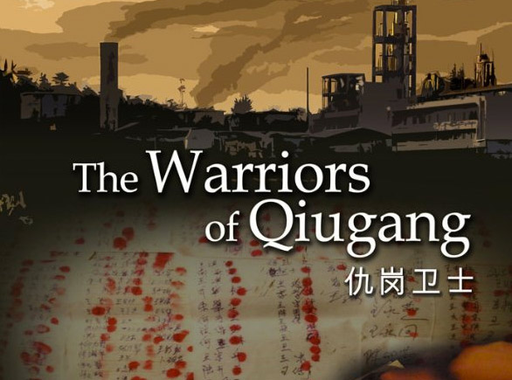
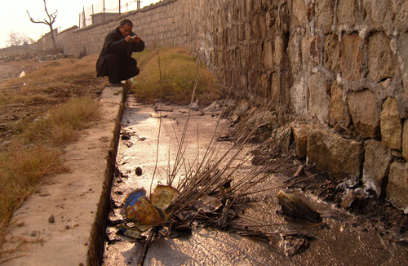
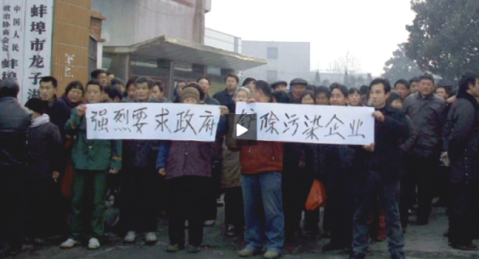
Quigang Warriors
Quigang, Anhui Province, 2004

Slide 8

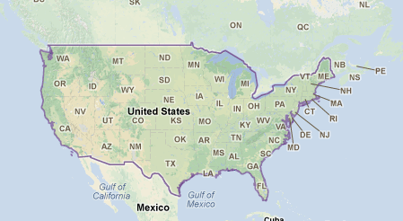
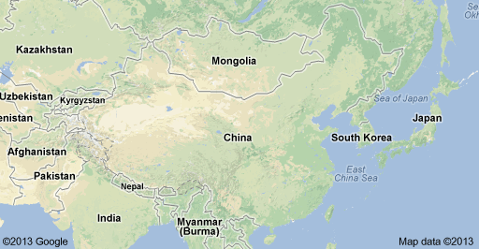
Regulations Today
USA
  NEPA
  Clean Air Act
  Clean Water Act
  CERCLA
    Regulate and control waste and emissions into the environment
China
  Measures for Registration of Hazardous Chemicals for Environmental Management
  Coal Ash Recycling Act amendments
  New air quality standards

Slide 9
What We Hope to Learn
How the public can participate in environmental affairs in a big city like Beijing
How local governments plan to integrate public opinion into decision making in provinces

Slide 10
What We Learned in China That We Didn’t Know Before
Toilets are not toilets
Chopsticks are a way of life
Crossing the street is the most dangerous activity
ALWAYS take a real taxi
You can barter anywhere, anytime
All rules are just suggestion

Slide 11
What We Learned in China Pertaining to Sustainability
Regulations on plant emissions are relatively new and slowly taking effect throughout the country.
Smog is still a huge problem for most of China. Instead of using public transportation, most people are buying cars to drive everywhere.
Smog is causing health problems, increasing the greenhouse gas content of the atmosphere, and blocking the sky from view more and more days out of the year.

Slide 12
What We Learned in China Pertaining to Sustainability
There is an enormous collaboration among scientists, planners and architects to update the city in the most environmental way possible
Innovative tactics are being implemented to reduce waste, increase air quality and save energy (e.g. the power plant and landfill we visited)
Higher standards on pollution and air quality are being enacted to help achieve these goals.

