Slide 1
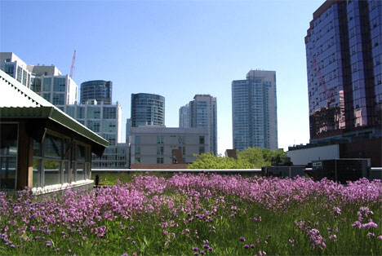
Urban Agriculture
Mary Wischmeyer - Architecture
McKenzie Spotts - Accounting

Slide 2
Here’s the Future
By the year 2050, nearly 80% of the earth's population will reside in urban centers.
An estimated 10⁹hectares of new land (about 20% more land than is represented by the country of Brazil) will be needed to grow enough food to feed population increase.
80% of the land that is suitable for raising crops is in use.
Historically, some 15% of that has been laid waste by poor management practices.

Slide 3
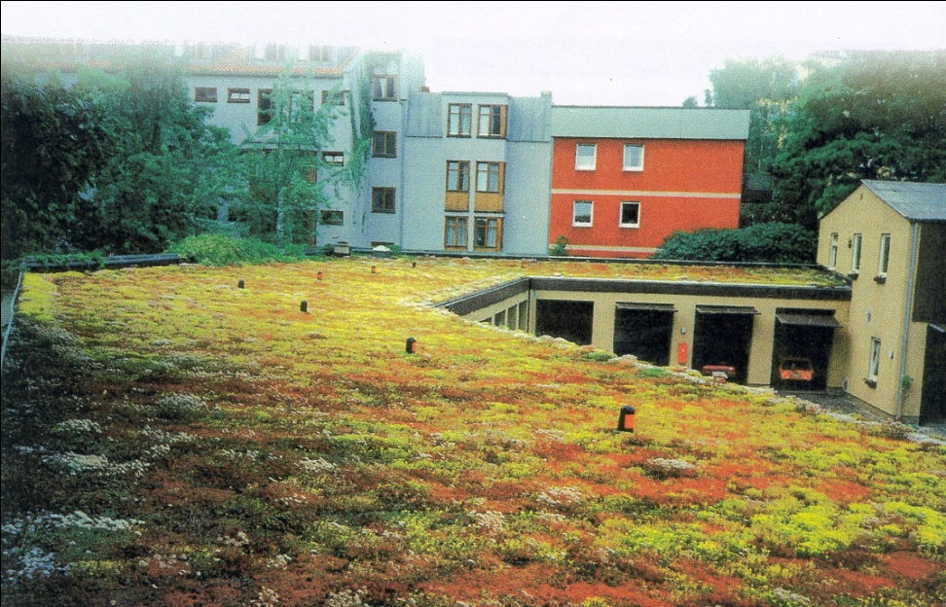
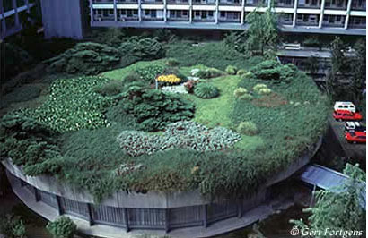
What is a Green Roof
Green roofs supplement traditional vegetation without disrupting urban infrastructure -- they take a neglected space and make it useful.

Slide 4
Pro’s and Cons of Green Roofs
They decrease "heat island" effect
The building with a green roof creates its micro-climate, so building is cooler in summer and warmer in winter. This means less energy is needed for air conditioning
It absorbs pollution and particles from air
It absorbs rainfall and reduces the load of water on sewage system
Protects Roof insulation material. Thus potentially doubling the roofs lifespan
They provide natural environment for birds, insects and small animals
Initial investment is significantly higher.
Weight of the green roof increases the load on the building and should be cafefully considered
Green roofs should be regularly maintained, depending on type of green roof.

Slide 5
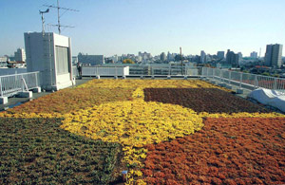
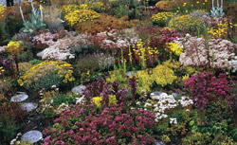
Types of Green Roofs: Extensive
Overall Depth:
3 - 5 inches
Weight max:
15- 25 lbs/ft²
Irrigation: no, not recommended
Plants: Mosses, Sedums, Succulents, Herbs and few Grasses
Costs: low
Proctor Hall

Slide 6
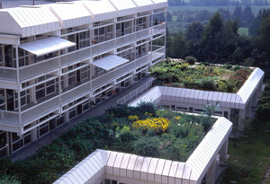
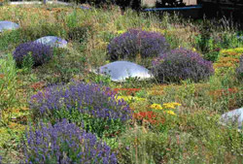
Types of Green Roofs: Semi-Intensive
Overall Depth:
5- 7 inches
Weight max:
25- 40 lbs/ft²
Irrigation: partially, as-needed
Plants: Mosses, Sedums, Succulents, Herbs and few Grasse Selected Perennials, Sedums, ornamental Grasses, Herbs and little Shrubs
Costs: medium

Slide 7
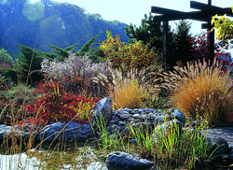
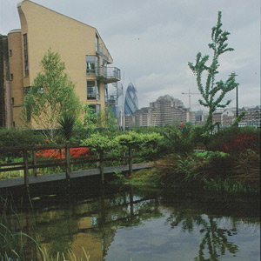
Types of Green Roofs: Intensive
Overall Depth:
7 - 24+ inches
Weight max:
35 - 80+ lbs/ft²
Irrigation: yes, automatic/flood
Plants: Mosses, Sedums, Succulents, Herbs and few Grasse Selected Perennials, Sedums, ornamental Grasses, Herbs and little Shrubs Perennials, Lawn, Putting green, Shrubs and Trees, rooftop farming
Costs: high
Zimmer Auditorium

Slide 8
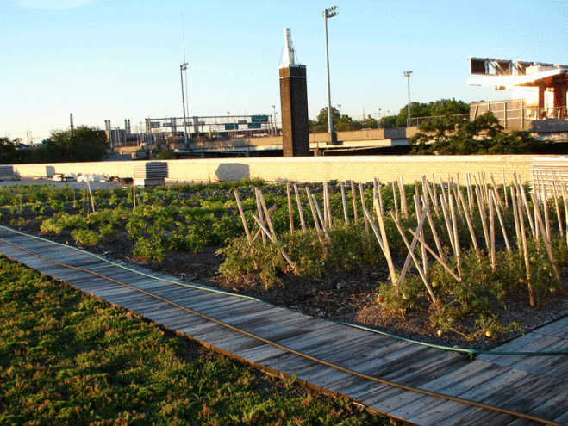
New York City Department of Parks and Recreation
In the spring of 2010, a 4,000 sf vegetable garden designed by Senior Project Manager Rick Gordon
vegetables including tomatoes, peppers, zucchini, yellow squash, string beans, broccoli, corn, lettuce, cucumbers, eggplant and mixed herbs.

Slide 9
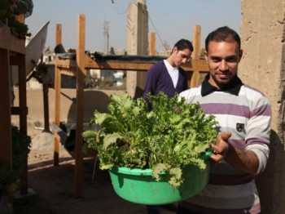
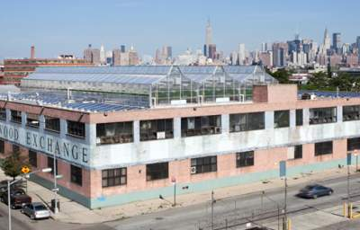
Hydroponic Green Roofs - Eygpt
Two Egyptian brothers have received enough donations to set up three rooftop farms in Maadi – a once wealthy suburb of Cairo.
Designed to become a secondary source of income for poor families
Closed loop, vertical hydroponic systems that use recycled water and mineral nutrient solutions to grow cheaper, healthier produce.

Slide 10
Urban Agriculture Potential
The average American meal travels 1500 miles from field to table
The sustainability of urban systems can be significantly bolstered by fostering a more urban agriculture
It is possible to produce a variety of fruit, grain, and vegetable crops on rooftops in a variety of ways.
If roof gardens are built into the original building plan, structural allowance can be made for several feet of soil, accommodating not only vegetable crops but also trees and shrubs.
Relatively new practice. Research and new ideas need to be tested. There is a lack of scientific proof to show how well reliable these gardens are as a food source.

Slide 11
Vertical Farming
Is it applicable for Chinese Cities?

Slide 12
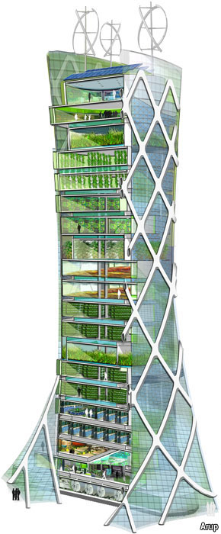
Vertical Farming
Recent ideas in past two decades
Less shipping/accessible to consumers
Controlled environment
Protected environment
Downfall: Sunlight through glass
Minimal production compared to farm land

Slide 13
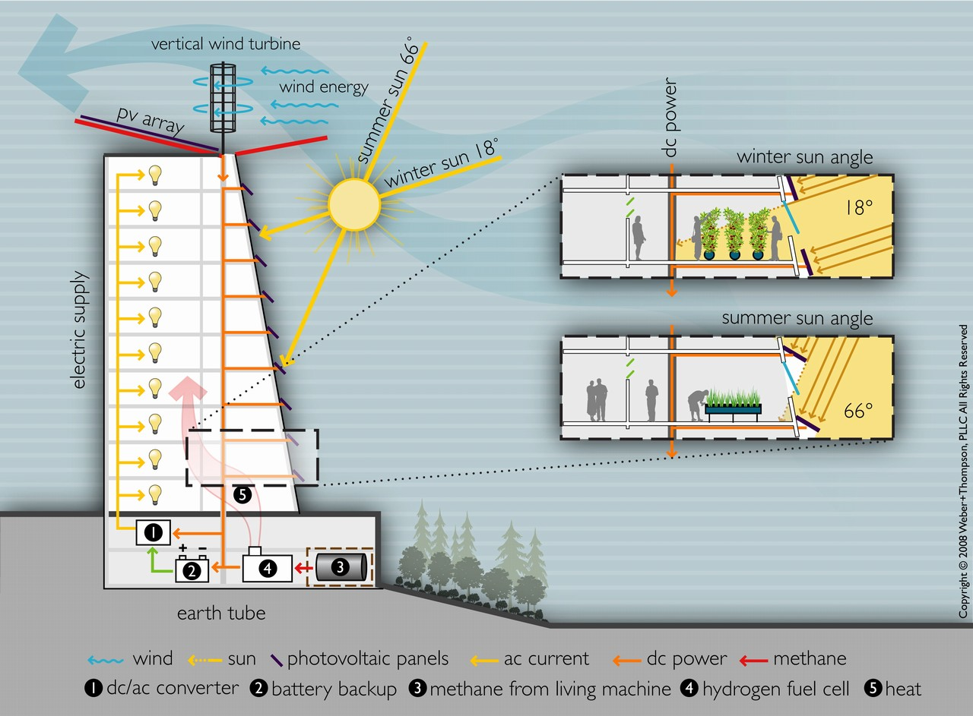

Slide 14
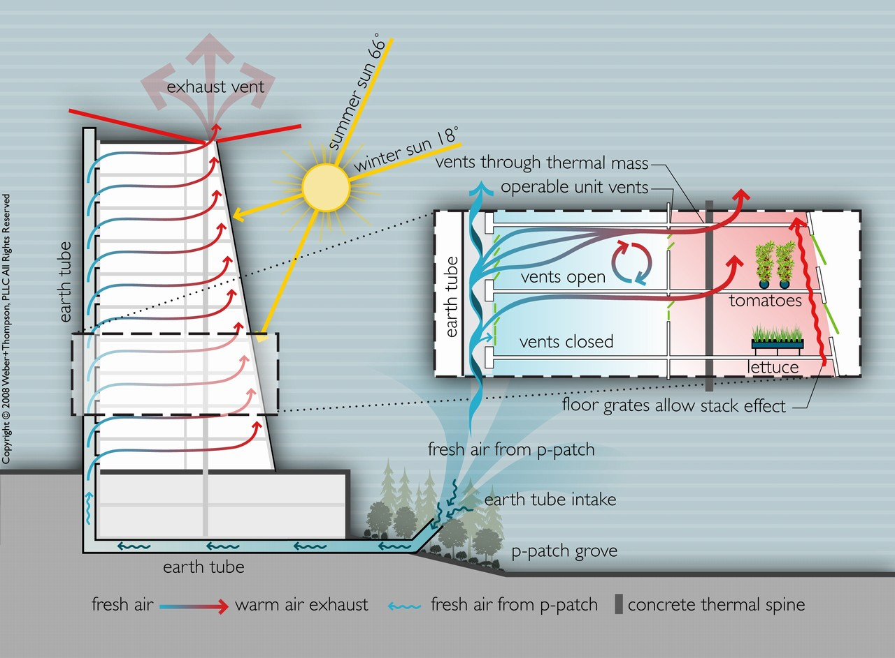

Slide 15
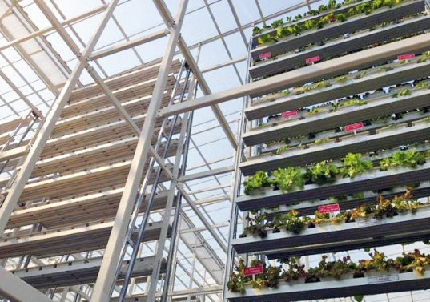
Case Study
Sky High Vegetables in Singapore
Slowly rotating on water-powered, aluminum A-frames
Supplying one of city's supermarkets with weekly deliveries of its greens. The Sky Greens produce costs around 40% more than an imported Chinese equivalent.
Singapore only produces around 7% of the vegetables it consumes.

Slide 16
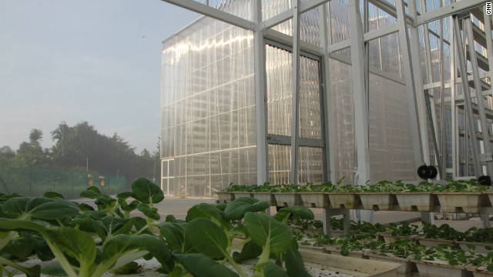
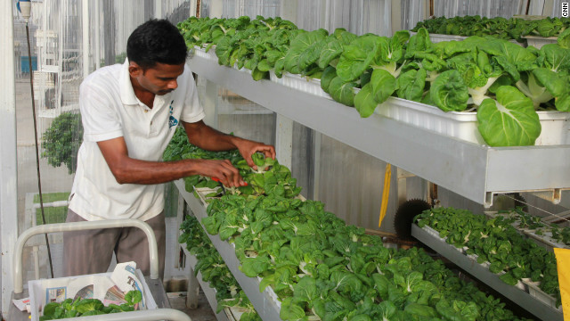
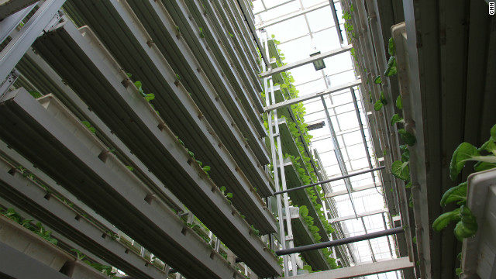

Slide 17
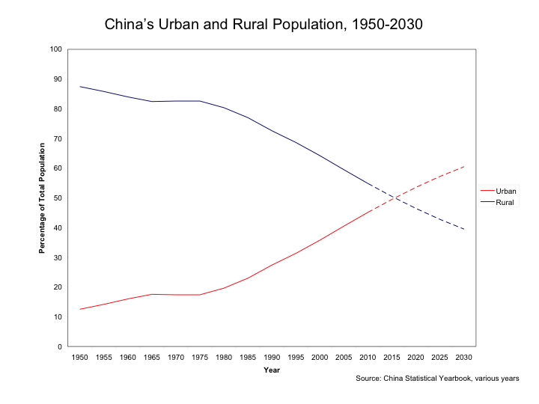

Slide 18
Questions
Due to rapid urbanization, are these urban agriculture methods applicable in Chinese Cities?
What does urban agriculture mean for the future of China’s food?
What are the steps the Chinese are taking to ensure access to fresh food?

Slide 19
Lessons Learned
While in China
Mckenzie Spotts
5/23/2013
Sustainable Urbanism

Slide 20
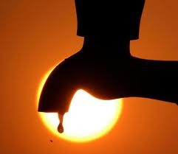
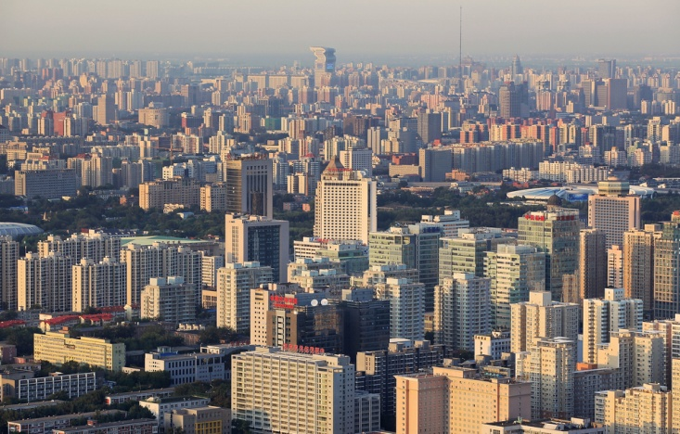
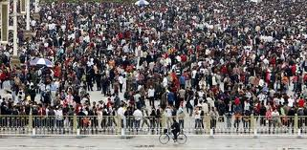
Urban Agriculture - Green Roofs in China
Green Roof systems that produce food are basically non-existent in China for a couple reasons:
  Not seen as plausible way to feed any portion of their population
  The green roof systems used to produce food are resource needy.

Slide 21
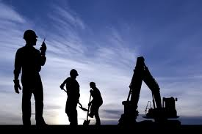

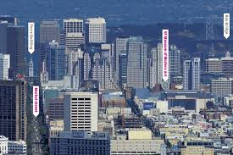
Green Roofs in China Cont.
  No one willing to build green roof systems capable of producing food.
  Very little research is being done to create systems that are adaptable and flexible enough to produce food.

Slide 22
Green Roofs in China – Cont.
There is a lot of research being done in China when it comes to becoming sustainable in every industry.
Green roofs are not at the top of the list right now as sustainable solutions.
There is a future for green roofs but the entire system most become more realistic for resource deprived situations.

Slide 23
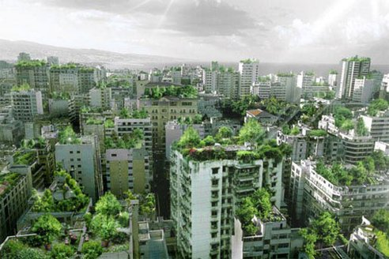
The End

