Slide 1
Transit-Oriented Design: China
Jake Holden

Slide 2
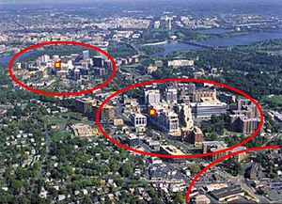
What is TOD?
Definition: A mixed-use commercial and residential area, designed to provide maximum access to public transit and encourage use of the system.
http://en.wikipedia.org/wiki/File:ArlingtonTODimage3.jpg

Slide 3
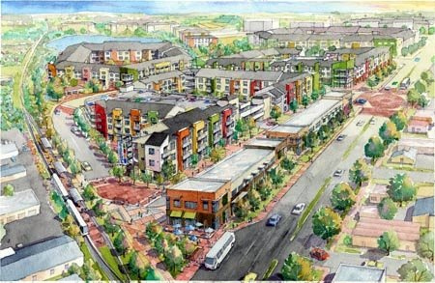
Features
A high-density development centered around a transit station or stop with a radius of about ¼ to ½ mi.
Pedestrian oriented
Fewer parking areas further to the periphery
http://switchboard.nrdc.org/blogs/kbenfield/transitoriented_development_re.html

Slide 4

Benefits
Significantly lower pollution due to cars
Reduced traffic
Shorter commuting time
Fewer trips necessary
Improved public health
Cost savings on vehicle infrastructure

Slide 5
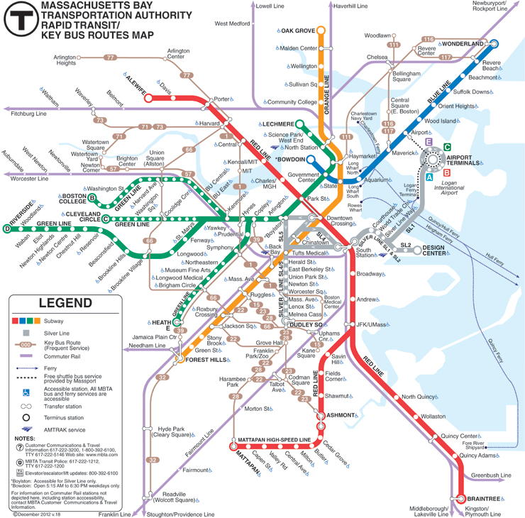
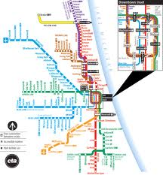
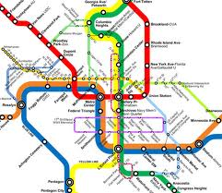
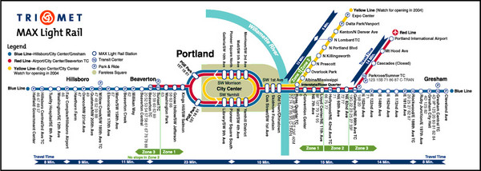
U.S. Examples
Boston
Chicago
Portland
Washington D.C.

Slide 6
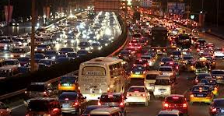
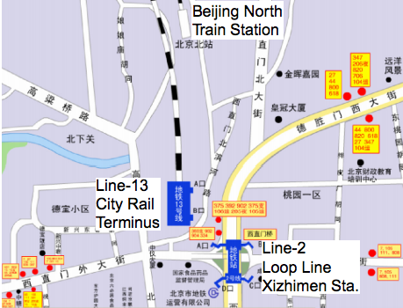
TOD in China
Chinese governments have realized that the automobile is not a sustainable mode of transportation for the population
Transit + Community Planning/Development=TOD

Slide 7
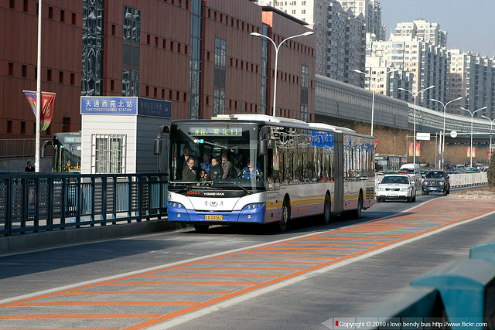
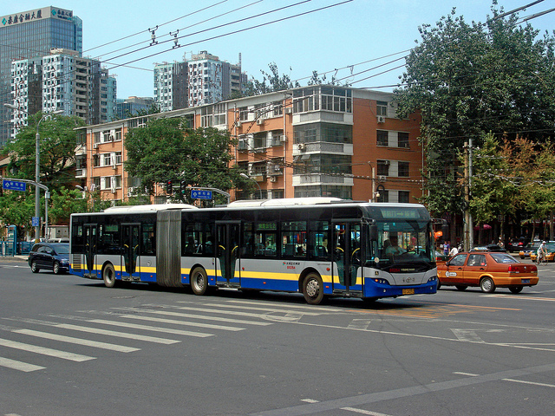
TODs: Beijing
It appears that with systems such as the BRT (Bus rapid transit), Beijing is moving towards a TOD mindset
However, traditional TODs may be too small of a scale for such a rapidly growing city

Slide 8
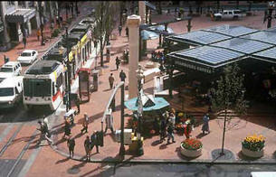
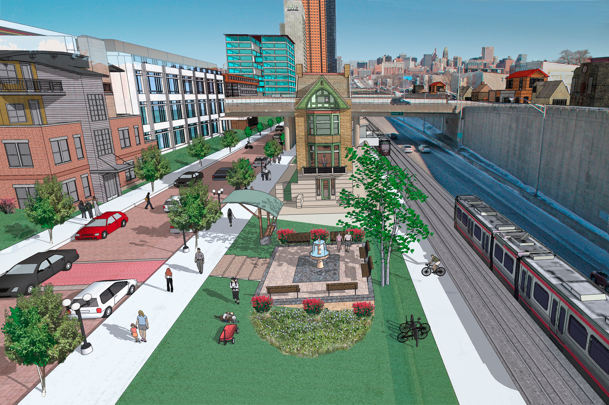
Implementation
Multidisciplinary field, requiring collaboration across the board from:
  Governments
  Planners
  Designers
  Engineers
  Corporate sector
Risks: Stratification, more car ownership

Slide 9
Comparison
United States
  Lower population
  Less government land power
  Investment from private sector
  More restricting regulations (Barriers)
China
  High population- easier to create dense developments
  Much more emphasis on urban development currently
  Sustainable design must become the norm to continue growth
  High incentive for government investment

Slide 10
What I learned
Since Beijing has such a history but is also one of the fastest growing cities in the world, it is clear that new is literally running over old.
If the development is not coordinated properly, the city will literally smother itself
Most importantly, due to the rapid urbanism and the obstacles encountered, China is on the path to becoming the most technologically advanced and organized country. There is no other country conducting the same amount of state funded research in areas like transportation and environmental issues.

Slide 11
References
Love, Nelson A. “Transit Oriented Development in America: A Suitability Study for Cincinnati,” Ohio. Diss. University of Cincinnati, 2010., n.d. Print.
Zhang, Ming. “Chinese Edition of Transit-Oriented Development.” 2006. Paper. Lincoln Institute of Land Policy, Cambridge, Massachusetts.
Belzer, Dena, and Gerald Autler.” TRANSIT ORIENTED DEVELOPMENT: MOVING FROM RHETORIC TO REALITY.” Tech., n.d. Print.
"Comprehensive Evaluation of Transit Oriented Development Benefits." Planetizen. N.p., n.d. Web. 09 Apr. 2013.
Transit Maps: mbta.com, cta.com, trimet.org, & wmata.com

