Slide 1
Sustainable Cities
可持续发展
城市
Benjamin Koontz
Prince Osemwengie
Matthew Robinson
Rachel Tobe
April 27, 2013
Sustainable Urbanism
Spring 2013
University of Cincinnati, USA

Slide 2
Outline
概述
Why sustainable cities?
What is a sustainable city?
Sustainable City Approaches
Smart Growth
Retrofitting Existing Cities
Building New Cities
Important questions to ask?

Slide 3
Why Sustainable Cities?
理由
为什么
Cities are growing:
Over 50% of the world population lives in urban areas
Increasing urban populations can cause problems in cities
Congestion, pollution, lack of resources
Notes:
Urban population quote: The World Bank, http://data.worldbank.org/region/WLD

Slide 4
A Sustainable City
可持续发展 城市
Development which meets the needs of the present without compromising the ability of future generations to meet their own needs.
Balanced system: social, economic, and ecological
Link local actions to global concerns

Slide 5
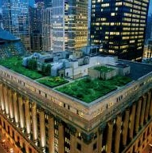
Sustainable City Ideals
策略
Smart growth
Energy conservation
Waste reduction
Multi-modal transportation
Water management
Notes:
Turbine: http://www.tuscolatoday.com/index.php/2012/04/28/additional-wind-turbines-given-nod-of-approval/
Recycling: http://www.photos-public-domain.com/2011/03/27/recycling-arrows-on-cardboard-box/
Transportation: NuRide, http://www.nuride.com/nuride/main/main_checked.jsp
Water: Greenroof on Chicago City Hall, http://ngm.nationalgeographic.com/2009/05/green-roofs/klinkenborg-text
Energy - Reduced energy, renewable sources
Waste - Reduced consumption, recycling, composting
Transport - Multi-modal, fast, efficient, convenient
Water - Stormwater management, flooding resilience

Slide 6
Sustainable City Approaches
战略
Smart Growth
Retrofitting Existing Cities
Building New Cities

Slide 7
Smart Growth Principals
智能增长
High density
Walkable neighborhoods
Diverse housing options & land uses
Community & stakeholder collaboration
Strong sense of place
Preservation of open space
Multimodal transportation
Compact building design
Direct development in existing communities

Slide 8
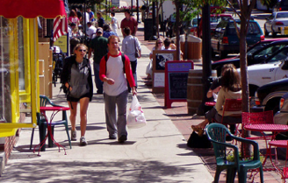
Walkable Neighborhoods
步行社区
Concentrate critical services near homes, jobs, & transit
Improved personal health & fitness
Expanded consumer choice
Adopt street design standards emphasizing pedestrians & non-motorized modes
Copenhagen Lane
Provide grants to local communities for improvement projects
Illinois Balanced Growth for a Better Quality of Life

Slide 9
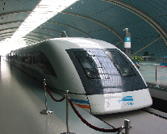
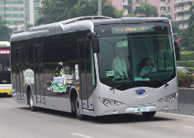
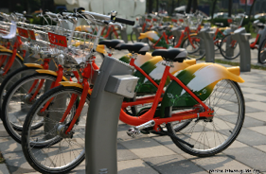
多模式交通
Multi-modal Transportation
Focus on neighborhood-scaled streets (two or four lanes)
Encourage high levels of connectivity
Require sidewalks in all new developments
Address parking needs & opportunities

Slide 10
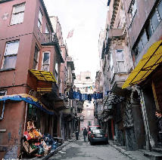
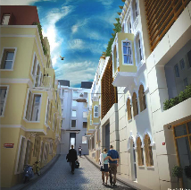
Develop in Existing Communities
加强社区
Strengthen local brownfield programs
Facilitate programs to encourage home renovation and rehabilitation in existing neighborhoods (Habitat for Humanity).
Use incentives for business & home owners to locate in areas with existing infrastructure

Slide 11
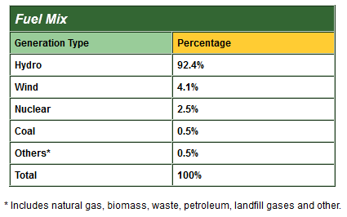
Seattle, Washington, USA
能源
Retrofitting Existing Cities
Energy
over 99% renewable energy
Notes:
Fuel Mix Table: Seattle City Light, http://www.seattle.gov/light/green/greenpower/greenuppr.asp
Photo: Skagit Hydroelectric Project, http://powerlines.seattle.gov/2013/03/07/skagit-hydroelectric-project-generates-500000-a-year-for-local-economy/

Slide 12
San Francisco, California, USA
垃圾
Retrofitting Existing Cities
Waste
City requires residents and businesses to separate their trash:
Blue – Recyclables
Green – Compostable
Black - Trash
80 % of waste not sent to landfills
Over 99% Renewable
Notes:
San Francisco Recology Bin Information: http://www.sfrecycling.com/index.php
Photograph: Flicker, Recycling and Resource Recovery Station at SF Green Festival, http://www.flickr.com/photos/44313045@N08/6339968506/

Slide 13
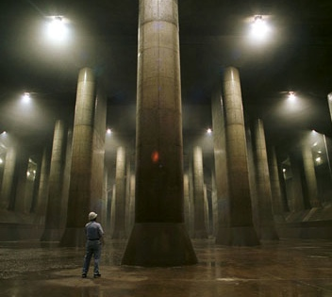
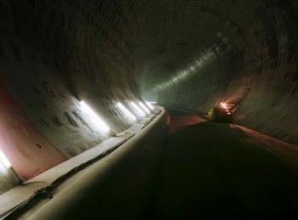
Saitama, Japan
水
Retrofitting Existing Cities
Water
Metropolitan Area Outer Discharge Channel
World's largest underground flood water diversion facility
Reduces flooding stress during typhoons & rain
80 % of waste not sent to landfills
Reduce flood area by 80%
Over 99% Renewable
Notes:
Photos: http://inhabitat.com/new-submission-33/
Info: http://www.water-technology.net/projects/g-cans-project-tokyo-japan/

Slide 14
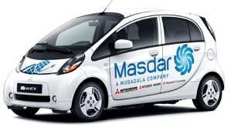
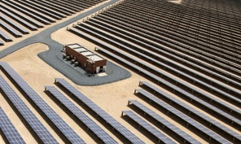
Madsar City, Abu Dhabi, United Arab Emirates
能源
Building New Cities
Energy
Planned orientation of buildings for maximum energy efficiency
Public transit is electric; pilot program for electric cars
A solar power plant provides all city energy needs
Notes:
Images and Info: http://masdarcity.ae/en/
Master Plan Orientation: seeking the maximum efficiency gains at the lowest cost by optimally orienting the city grid and buildings to minimize solar heat gain on building walls and the street, while maximizing cooling nighttime breezes.
Electric Transportation: In addition, a public transport system of electric buses, electric cars, and other clean-energy vehicles will provide transport within the city. Pilot Project: Electric Vehicles at Masdar Institute
Energy: A 10MW solar photovoltaic plant is already operational within Masdar City, the largest such solar plant in the Middle East. It powers the first Masdar Institute buildings, the temporary Masdar administration buildings and many ongoing construction activities on site. Built across 22 hectares by Abu Dhabi-based Enviromena, the plant was connected to the Abu Dhabi power grid in April 2009 and consists of 50% thin film photovoltaic modules and 50% polycrystalline photovoltaic modules.

Slide 15
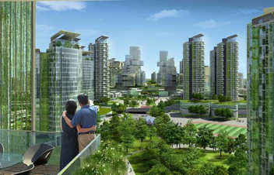
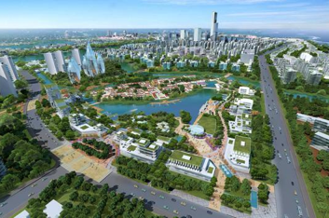
Tianjin Eco-city, Tianjin, China
生活品质
Building New Cities
Quality of Life
"In the past, so-called eco-cities have been built in ecologically important areas or on useful arable land. We wanted to show that it's possible to clean up a polluted area and make it useful and livable.”
- Ho Tong Yen (head of Sino-Singapore Tianjin Eco-city Development &Investment)
Notes:
Photo 1 & 3: http://www.bbc.com/future/story/20120503-sustainable-cities-on-the-rise
Photo 2: http://www.dac.dk/en/dac-cities/sustainable-cities-2/all-cases/master-plan/tianjin-a-model-eco-city-in-the-eastern-world/
http://www.tianjinecocity.gov.sg/bg_intro.htm
-The Sino-Singapore Tianjin Eco-city’s vision is to be a thriving city which is socially harmonious, environmentally-friendly and resource-efficient.
http://www.bbc.com/future/story/20120503-sustainable-cities-on-the-rise
-When completed around 2020, it will have an estimated 350,000 residents.
http://www.tianjinecocity.gov.sg/bg_kpis.htm
-The planning and development of the Eco-city is guided by a comprehensive set of Key Performance Indicators (KPIs) covering its ecological, economic and social development. These KPI’s include:
Good Natural Environment (air quality, water quality and cleanliness, etc.), healthy balance in the man-made environment (proportion of green buildings, native vegetation index, and per capita public green space), Good lifestyle habits (overall recycling rate, waste treatment, amount of free public housing, etc.), developing a dynamic and efficient economy (usage of renewable energy, use of water from non-traditional sources, employment-housing ratio index, etc.)
http://www.tianjinecocity.gov.sg/bg_masterplan.htm
-The Tianjin Eco-city's Master Plan spells out the approved uses of its land. The Plan attempts to strike a balance between competing needs, including the social, economic and environmental needs of the Eco-city.
-"1 Axis" – this refers to the Eco-valley cutting across the Eco-city, which is the green spine of the city. It links up the City Centre, the 2 sub-centres and the 4 districts in the Eco-city, and provides a scenic trail for pedestrians and cyclists. The tram system, which will be built to meet the Eco-city's transport needs, will run along the Eco-valley. "3 Centres" – this refers to the main City Centre on the promontory on the south bank of the Old Ji Canal and the two sub-centres in the south and the north. "4 Districts" – this refers to the residential districts in the southern, central, northern and north-eastern parts of the Eco-city. Each district contains several housing neighbourhoods comprising a variety of housing types, as well as their respective commercial and amenity centres serving their communities.

Slide 16
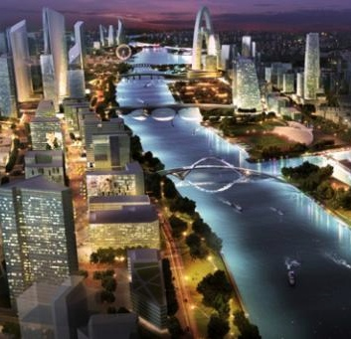
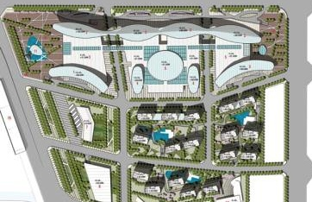
Tongzhou New City, Beijing, China
低碳
Building New Cities
“Pedestrian-first” transit & open space network
20% carbon footprint reduction
Smart energy grid
Cyclical utilization of water resources
Notes:
http://www.aecom.com/vgn-ext-templating/v/index.jsp?vgnextoid=b5cdc892ca1a9310VgnVCM100000089e1bacRCRD&vgnextchannel=865721f642b81310VgnVCM100000089e1bacRCRD&vgnextfmt=default

Slide 17
Important Questions
问题
Balance of power?
Government’s role in sustainability/smart growth
Can large cities practice smart growth?
Beijing is expanding & growing
What is a sustainable city in China?
Design components, public opinion
Is growth sustainable?
Limited resources (food) as cities expand into agricultural land
?

Slide 18
Sources
参考资料
A before and after of Ficici Abdi Sokagi. Digital image. Jadde-Ye-Kabir. WordPress, n.d. Web. <http://jaddeyekabir.files.wordpress.com/2012/07/picture6-7_tarlabasi-before-and-after.jpg>.
"Building a Low Carbon Metropolis." AECOM News + Media. AECOM, 6 Sept. 2012. Web. <http://www.aecom.com/vgn-ext-templating/v/index.jsp?vgnextoid=b5cdc892ca1a9310VgnVCM100000089e1bacRCRD&vgnextchannel=865721f642b81310VgnVCM100000089e1bacRCRD&vgnextfmt=default>.
Cook, Diane, and Len Jenshel. Up on the Roof. Digital image. Green Roofs. National Geographic, May 2009. Web. <http://ngm.nationalgeographic.com/2009/05/green-roofs/klinkenborg-text>.
"David's Formosa Photo Gallery." Taiwan Guide. N.p., n.d. Web. <http://photos.taiwan-guide.org/index.php>.
Drier, Mary. "Additional Wind Turbines given Nod of Approval." Tuscola Today, 28 Apr. 2012. Web. <http://www.tuscolatoday.com/index.php/2012/04/28/additional-wind-turbines-given-nod-of-approval/>.
"G-Cans Project, Kasukabe, Saitama, Greater Tokyo Area, Japan." G-Cans Project, Kasukabe, Saitama, Greater Tokyo Area. Water-Technology.net, n.d. Web. <http://www.water-technology.net/projects/g-cans-project-tokyo-japan/>.
Hope, Mae. "Next Steps." Smart Growth. Blogspot, n.d. Web. <http://smartgrowth2011.blogspot.com/>.
Madsar City Images. Digital image. N.p., n.d. Web. <http://masdarcity.ae/en/>.
Metropolitan Area Outer Discharge Channel. Digital image. N.p., n.d. Web. <http://inhabitat.com/new-submission-33/>.
"Percent Urban Population." World Data Indicators. World Bank, 2011. Web. <http://data.worldbank.org/region/WLD>.

Slide 19
Sources continued
参考资料
Recycling and Resource Recovery Station at SF Green Festival. Digital image. Flicker. N.p., n.d. Web. <http://www.flickr.com/photos/44313045@N08/6339968506/>.
Recycling Arrows on Cardboard Box. Digital image. Photos Public Domain, n.d. Web. <http://www.photos-public-domain.com/2011/03/27/recycling-arrows-on-cardboard-box/>.
"Seattle City Light | Green Up | Power Content." Green Up: Power Content. Seattle City Light, 2001. Web. <http://www.seattle.gov/light/green/greenpower/greenuppr.asp>.
"Skagit Hydroelectric Project Generates $500,000 a Year for Local Economy." Power Lines. Seattle City Light, n.d. Web. <http://powerlines.seattle.gov/2013/03/07/skagit-hydroelectric-project-generates-500000-a-year-for-local-economy/>.
"This Week on Foot." Where the Sidewalk Starts. N.p., 15 Feb. 2013. Web. <http://www.wherethesidewalkstarts.com/>.
"Three Bin Information." Recology - Waste Zero. N.p., n.d. Web. <http://www.sfrecycling.com/index.php>.
"Tianjin: A Model Eco-city in the Eastern World." Sustainable Cities. DAC & Cities, n.d. Web. <http://www.dac.dk/en/dac-cities/sustainable-cities-2/all-cases/master-plan/tianjin-a-model-eco-city-in-the-eastern-world/>.
Tongzhou Master Plan. Digital image. Laguarda Low, n.d. Web. <http://www.laguardalow.com/projects/asia/tongzhou-master-plan/>.
Vince, Gaia. "China's Eco-cities: Sustainable Urban Living in Tianjin." Future - Smart Planet. BBC, 3 May 2012. Web. <http://www.bbc.com/future/story/20120503-sustainable-cities-on-the-rise>.
Visiting SLAC. SLAC National Accelerator Laboratory, n.d. Web. <http://www6.slac.stanford.edu/visiting-slac/>.

Slide 20
Lessons Learned
Benjamin Koontz
Matthew Robinson
Rachel Tobe
May 23, 2013
Sustainable Urbanism
Spring 2013
University of Cincinnati, USA

Slide 21
Outline
Solid Waste Management
Population & Development Rates
Transportation Planning

Slide 22
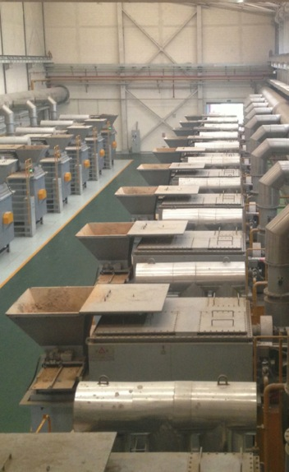
Solid Waste Management
Waste to Fertilizer

Slide 23
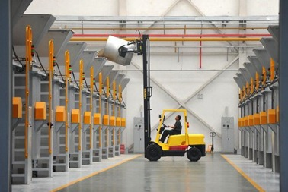
Waste to Fertilizer
Impact
Less waste in Landfill
Brings money into the city through sale of fertilizer
Fertilizer Production
Uses gathered food waste
Large containers hold the waste while it decomposes into fertilizer

Slide 24
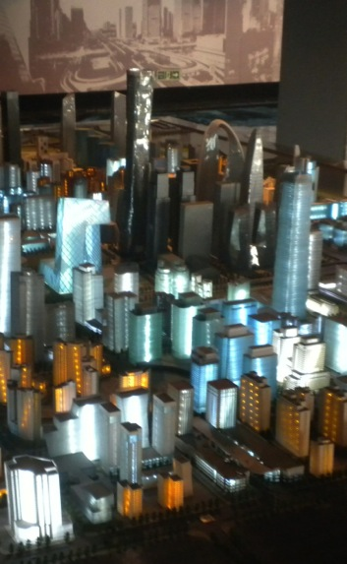
Population & Development Rates
The Population Issue
Soaring Construction Levels

Slide 25
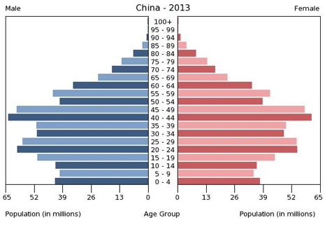
The Population Issue:
China’s current population: 1.35 billion
Estimated urban population: 690.8 million
We never considered the impact this massive population migration might do to a city.
“… it also points to the challenges facing Chinese leaders as mass migration places an increasing strain on urban housing, transport and welfare, while fueling pollution, social unrest and demands for political reform.”
By Jeremy Page and Bob Davis in Beijing and James T. Areddy in Shanghai
Notes:
http://online.wsj.com/article/SB10001424052970203735304577166652002366514.html
https://www.cia.gov/library/publications/the-world-factbook/geos/ch.html

Slide 26
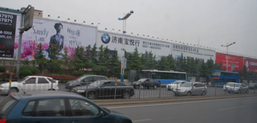
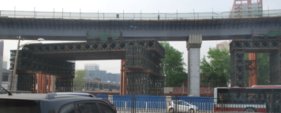
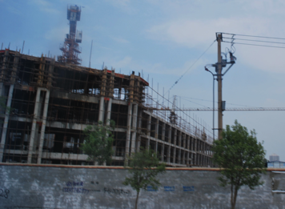
With new cities going up everywhere, we wonder whether these cities actually get filled?
Soaring Construction Levels
You have to have a good imagination when dealing with this development.
The population really is all heading to the cities…
No one is sure of whether or not its going to be filled, truth is that a lot of people are moving and they fill up and sell out all the time.
- BLVD
over 99% renewable energy
Notes:
BLVD
Photos from students

Slide 27
Transportation Planning
A Multi-Modal System
Planning for the Automobile
Changes in City Scale

Slide 28
Multi-Modal System
Chinese High Speed Rail
Beijing to Jinan (250 mi)
30 USD – 1.5 hours
Chinese Traditional Rail
Jinan to Beijing (250 mi)
12 USD – 6 hours
American Traditional Rail: D.C. to NYC (230 mi) costs 310 USD – 2 hours 45 min

Slide 29
Multi-Modal System
Bus System
Electric Buses (Beijing)
BRT Lanes, Stations (Jinan)
Subway System
17 lines (Beijing)
0.32 USD per ride

Slide 30
Transportation Planning
A Multi-Modal System
Planning for the Automobile
Changes in City Scale

Slide 31
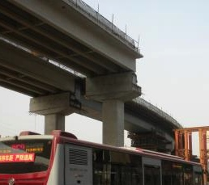
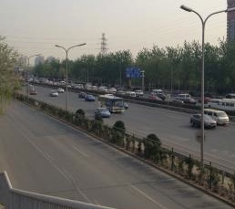
Planning for the Automobile
Beijing’s signature ring road development (6 ring roads encircling the city
Construction of elevated expressways over major thoroughfares

Slide 32
Transportation Planning
A Multi-Modal System
Planning for the Automobile
Changes in City Scale

Slide 33
Changes in City Scale
Differences in city scale influence sustainability efforts:
Population
Beijing (20 million)
Jinan (5.5 million)
Providing adequate public transport becomes more difficult with larger populations (Beijing).

Slide 34
Changes in City Scale
Jinan’s successful BRT System (smaller scale city)
Six dedicated routes with separate lanes & stations
Working to implement traffic signal priority for buses

