Slide 1
Green Buildings
Joey Bellon
Mike Knadler
Diana Chan

Slide 2
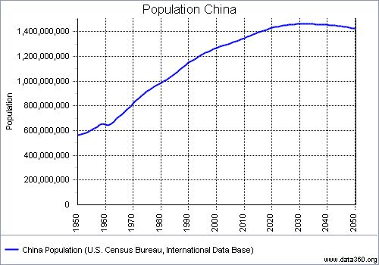
Current Population

Slide 3
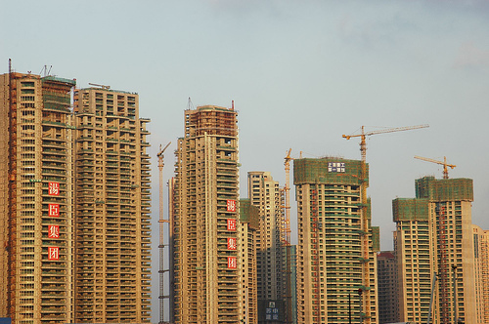
State of the Republic
One new high rise building constructed every five days – Use high energy levels

Slide 4
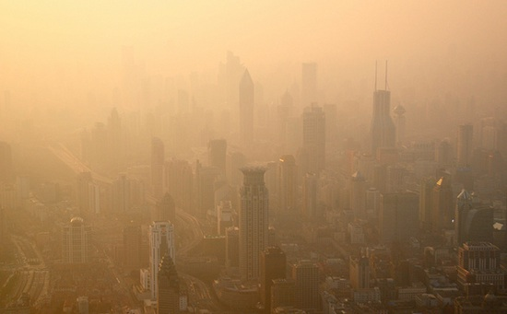
Five-Year Plan
Five-Year Plan: "reduce energy consumption by 16%”

Slide 5
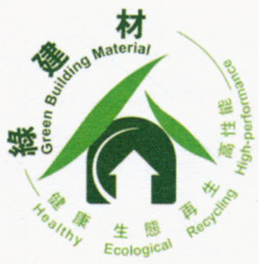
Chinese Green Building Evaluation Standard
Launched in 2006, formally carried out in 2008
Similar to LEED in US: Green Building Label
Assesses building based on energy usage, water efficiency, maintenance, air quality, etc.

Slide 6
Three Star Evaluation - Residential

Slide 7
Three Star Evaluation - Public

Slide 8
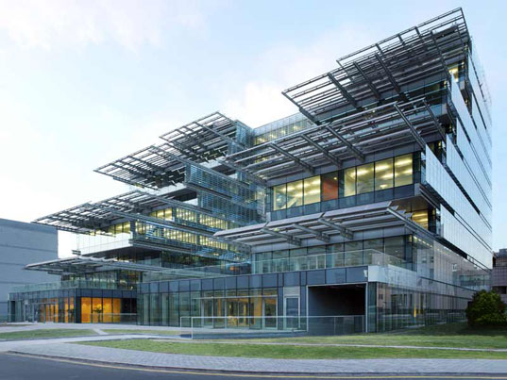
Sino-Italian Ecological and Energy-Efficient Building (SIEEB) - Beijing
Tsinghua University
Maximize Solar Capabilities for Energy Efficiency

Slide 9
What we Learned: SIEEB
Building envelope closed towards north to protect from winds, open to south for sun
Semi-reflective glazed louvers move with sun
Reflect more solar radiation in summer, less in winter
Smart lighting systems adjusts artificial light levels based on natural light levels
Envelope elements reflect more natural light into building
Photovoltaic cells on building exterior
Combined Heat and Power (CHP) System
Gas motors and electric generators produce energy
Heat from engines used for heating and hot water production

Slide 10
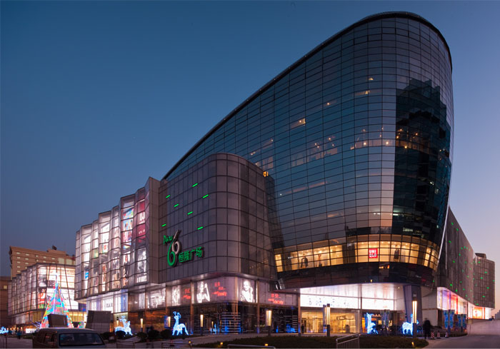
Parc 66 - Jinan
LEED Gold Rating
Comprehensive Recycling and Electric Systems

Slide 11
What We Learned: Parc 66
Double glazed facades for insulation
Photovoltaic cells on exterior
Water recycling for non-potable uses
Bicycle racks to encourage more sustainable forms of transportation

Slide 12
Architecture 2030 – Carbon Neutral by 2030

Slide 13
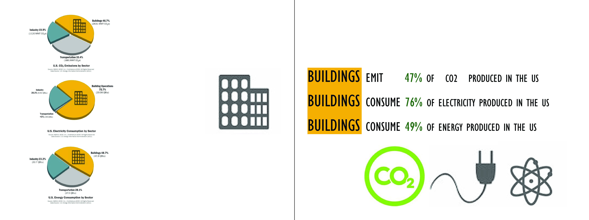

Slide 20
Sources
Geoff. "China Green Buildings." : Ministry of Construction Green Building Evaluation Standard- The “Three Star” System. China Green Buildings, 24 Feb. 2009. Web. 08 Apr. 2013.
"The Development of Green Buildings in China - 2012 China (Beijing) International Energy Saving and Environmental Protection Exhibition." The Development of Green Buildings in China - 2012 China (Beijing) International Energy Saving and Environmental Protection Exhibition. ENERCHINA, n.d. Web. 08 Apr. 2013.

