Slide 1
Vertical Farming
Is it applicable for Chinese Cities?

Slide 2
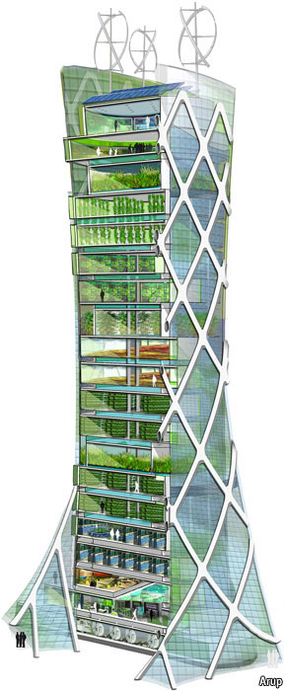
Vertical Farming
Recent ideas in past two decades
Less shipping/accesible to consumers
Controlled environment
Protected environment
Downfall: Sunlight through glass
Minimal production compared to farm land

Slide 3
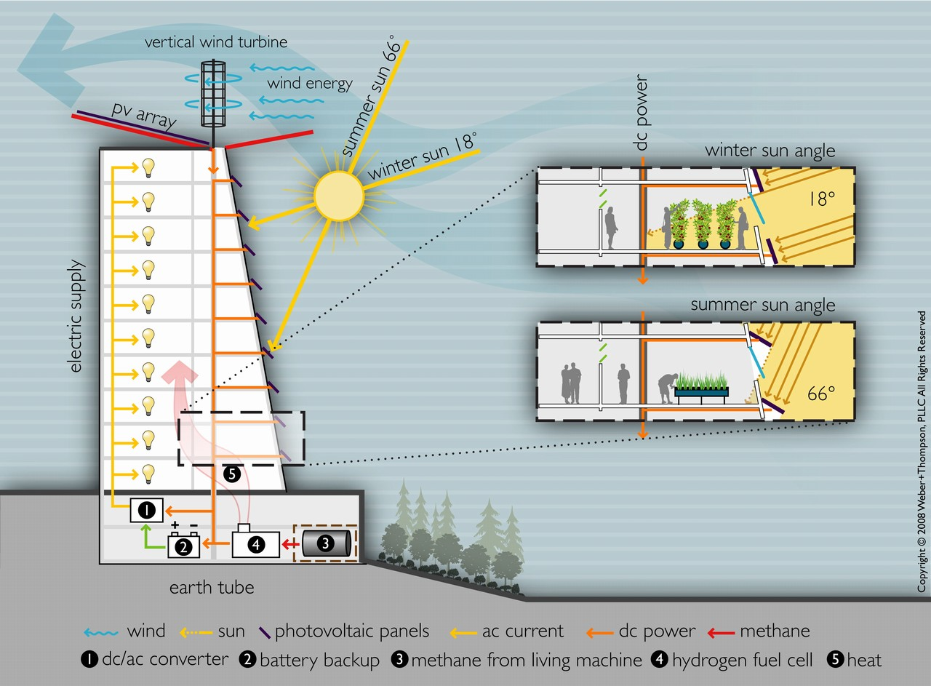

Slide 4
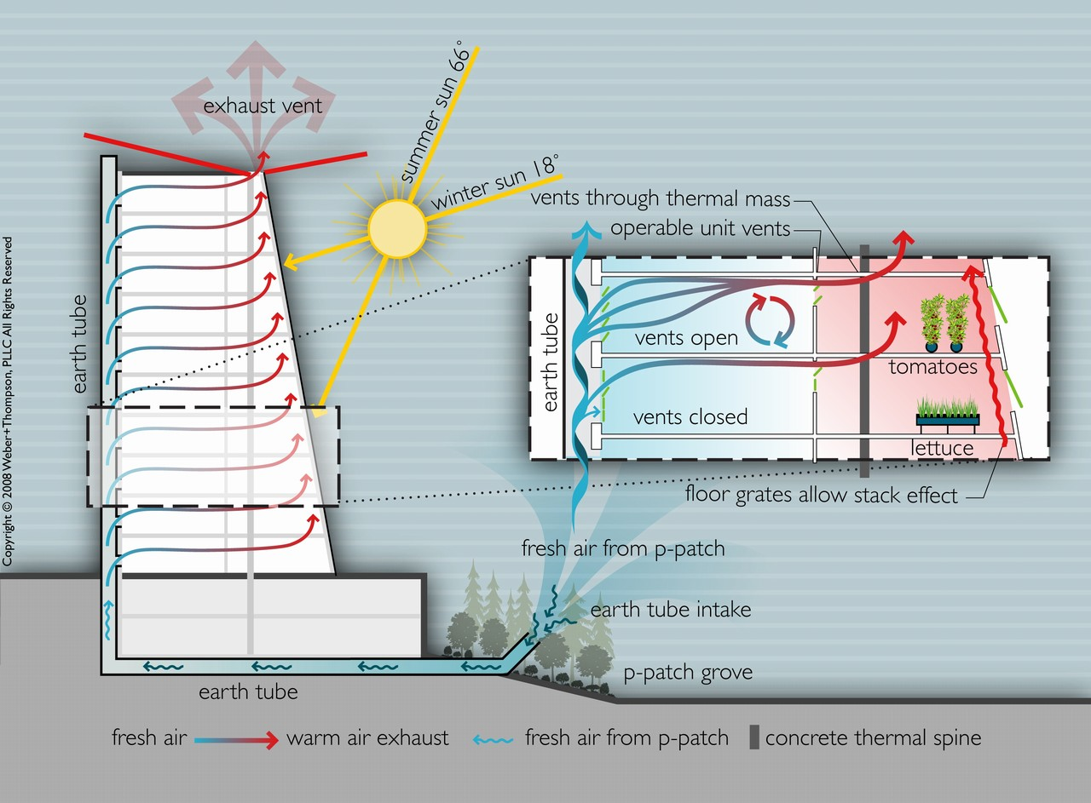

Slide 5
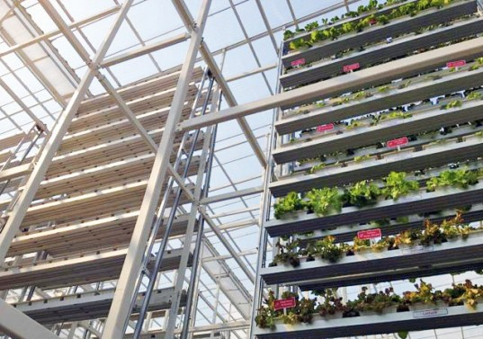
Case Study
Sky High Vegetables in Singapore
Slowly rotating on water-powered, aluminum A-frames
Supplying one of city's supermarkets with weekly deliveries of its greens. The Sky Greens produce costs around 40% more than an imported Chinese equivalent.
Singapore only produces around 7% of the vegetables it consumes.

Slide 6
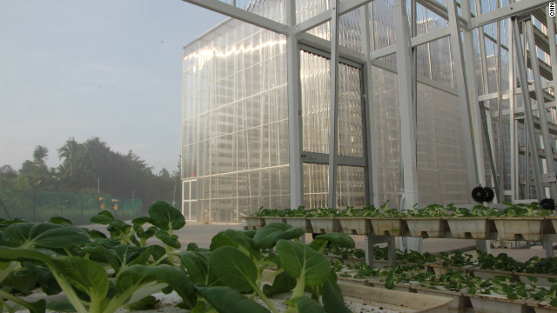
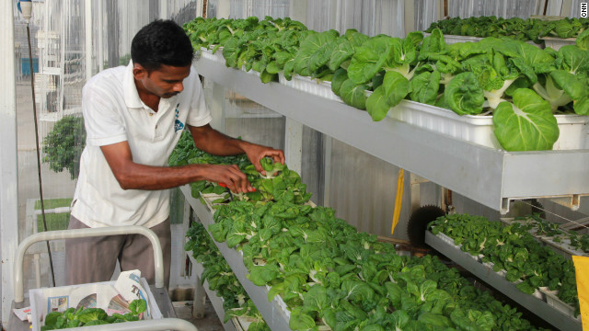
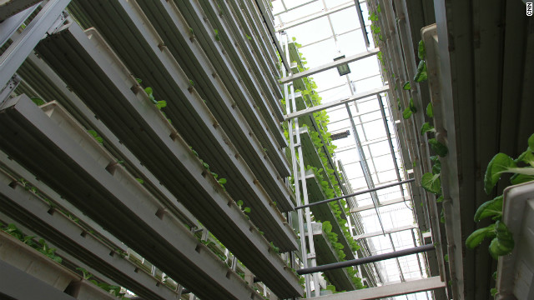

Slide 7
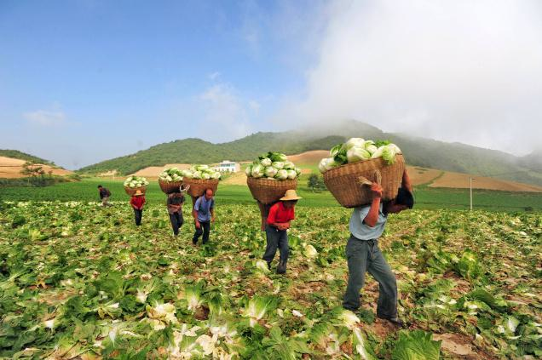
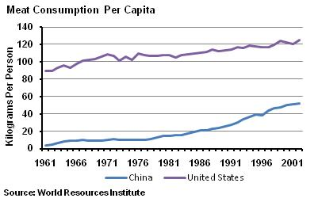
Chinese Diet
Chinese Diet: Rice, Fruits, Veggies. Increasing meat consumption
Chinese Diet: 8:1:1 pattern of 8 parts grain, 1 part meat, and 1 part vegetables to a 4:3:3

Slide 8
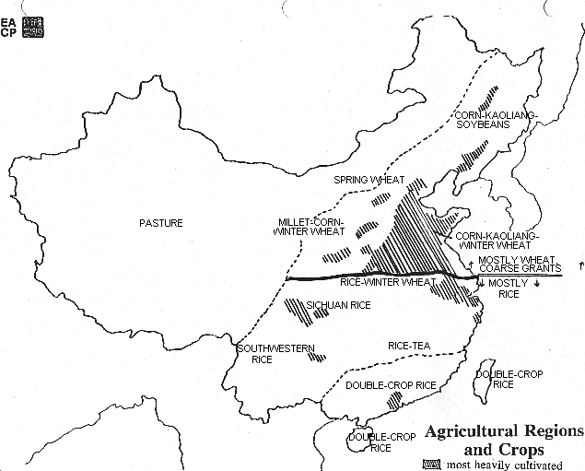
Chinese Crops
Grain Crops: Wheat, Corn, Soybeans, Rice
Cash Crops: Cotton, Peanuts, Sesame, Sugarcane, Beets Tea, Tobacco, Mulberry, and Fruit.

Slide 9
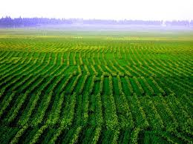
Vertical Farming Applicable in China?
Large population
Urbanization and shipping costs
Decreasing farmland
Government outlawed golf courses, race tracks, etc. in farming areas

