Slide 1
Jinan China

Slide 2
Jinan Facts
Jinan is the capital of Shandong in Eastern China
The city, which holds sub-provincial administrative status, is located in north-western Shandong about 400 kilometres (250 mi) south of the national capital of Beijing.

Slide 3
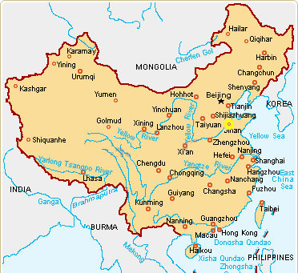
Jinan Map

Slide 4
Jinan points of Interest
Daming lake
Thousand Buddha Mountain
Lingyan Temple
Four-gates pagoda

Slide 5
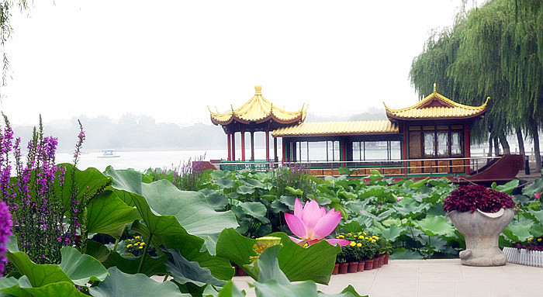
Daming Lake
The park is famous for Daming Lake (also known as the Lake of Great Light) which is a natural lake formed from many springs.
many festivals and activities take place here every year, including the Temple Fair in Spring Festival, the New Year Flower Exhibition, the Lotus Exhibition, different folk festivals, and a wonderful Stone Exhibition.

Slide 6
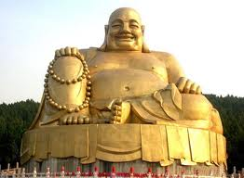
Thousand Buddha Mountain
The Thousand Buddha Mountain is a small hill located about 2.5 kilometres southeast from the center of the city of Jinan
The Thousand Buddha Mountain Public Park is flanked by a cemetery honoring the fallen of the Xinhai Revolution of 1911 on the east side, the Shandong Provincial Museum to the northeast, and the Jinan Botanical Garden on the west side.

Slide 7
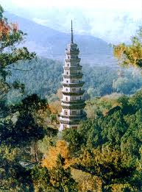
Lingyan Temple
The temple grounds are situated in a valley on the western edge of the Taishan range.
The Lingyan Temple has a long recorded history, and was one of the main temples in China during the times of the Tang and Song Dynasties.

Slide 8
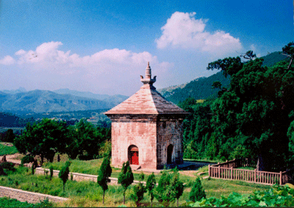
Four-gates pagoda
The Four Gates Pagoda is located at the foot of Qinglong Mountain, near Liubu Village, in Licheng District, under the administration of Jinan City, about 33 kilometers southeast of the city of Jinan proper.
The pagoda is located to the east of the site of the Shentong Temple (Chinese; pinyin; literally "Supernatural Power Temple"), which was one of the most important temples in northern China at the time the pagoda was built but is now in ruins.

