Slide 1
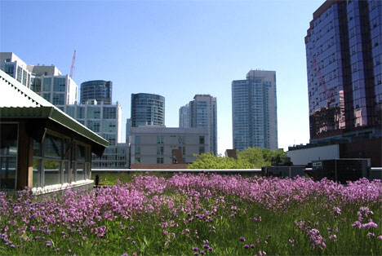
Green Roofs
Urban Agriculture

Slide 2
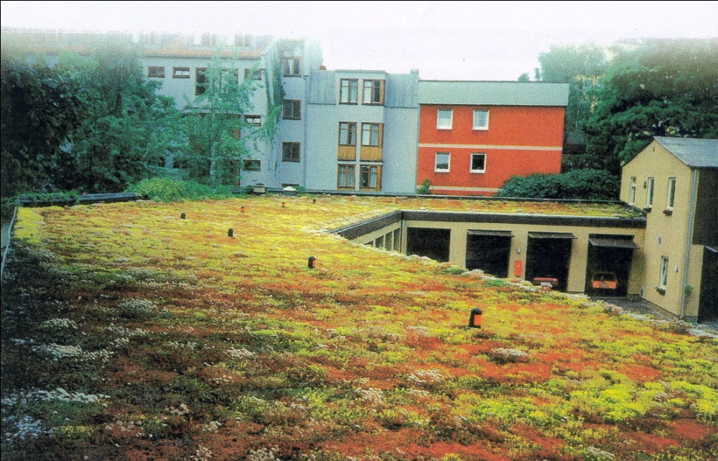
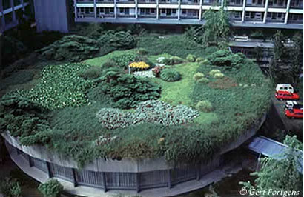
What is a Green Roof
Green roofs supplement traditional vegetation without disrupting urban infrastructure -- they take a neglected space and make it useful.

Slide 3
Pro’s and Cons of Green Roofs
They decrease "heat island" effect
The building with a green roof creates its micro-climate, so building is cooler in summer and warmer in winter. This means less energy is needed for air conditioning
It absorbs pollution and particles from air
It absorbs rainfall and reduces the load of water on sewage system
Protects Roof insulation material. Thus potentially doubling the roofs lifespan
They provide natural environment for birds, insects and small animals
Initial investment is significantly higher.
Weight of the green roof increases the load on the building and should be cafefully considered
Green roofs should be regularly maintained, depending on type of green roof.

Slide 4
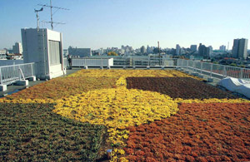
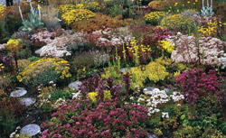
Types of Green Roofs: Extensive
Overall Depth:
3 - 5 inches
Weight max:
15- 25 lbs/ft²
Irrigation: no, not recommended
Plants: Mosses, Sedums, Succulents, Herbs and few Grasses
Costs: low
Proctor Hall

Slide 5
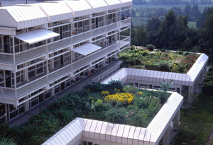
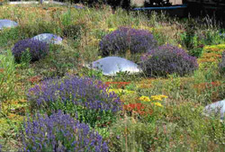
Types of Green Roofs: Semi-Intensive
Overall Depth:
5- 7 inches
Weight max:
25- 40 lbs/ft²
Irrigation: partially, as-needed
Plants: Mosses, Sedums, Succulents, Herbs and few Grasse Selected Perennials, Sedums, ornamental Grasses, Herbs and little Shrubs
Costs: medium

Slide 6
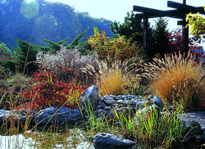
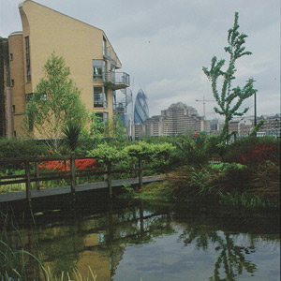
Types of Green Roofs: Intensive
Overall Depth:
7 - 24+ inches
Weight max:
35 - 80+ lbs/ft²
Irrigation: yes, automatic/flood
Plants: Mosses, Sedums, Succulents, Herbs and few Grasse Selected Perennials, Sedums, ornamental Grasses, Herbs and little Shrubs Perennials, Lawn, Putting green, Shrubs and Trees, rooftop farming
Costs: high
Zimmer Auditorium

Slide 7
Project Name: Trent University Environmental and Resource Sciences Vegetable Garden
Year: 1996
Owner: Trent University
Location: Peterborough, Canada
Type: Intensive, Test/Research
Size: 30000 sq.ft.
Purpose: monitor ozone levels and conduct environmental research and to raise 30 to 40 different crops of produce which is donated.
The rooftop garden has a depth of 18 inches of media
vegetables such as artichoke, sweet potatoes, squash, kale, beets, carrots, radishes, broccoli, peppers, zucchini, beans, turnips, eggplants, melons, pumpkins, and ground cherries.
http://www.greenroofs.com/projects/pview.php?id=558

Slide 8
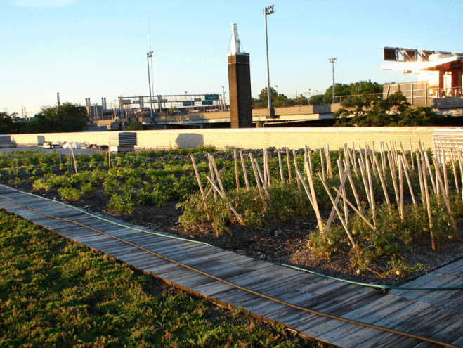
Five Borough Technical Services Division of the New York City Department of Parks and Recreation
In the spring of 2010, a 4,000 sf vegetable garden designed by Senior Project Manager Rick Gordon
vegetables including tomatoes, peppers, zucchini, yellow squash, string beans, broccoli, corn, lettuce, cucumbers, eggplant and mixed herbs.

Slide 9
Urban Agriculture Potential
The average American meal travels 1500 miles from field to table
The sustainability of urban systems can be significantly bolstered by fostering a more urban agriculture
It is possible to produce a variety of fruit, grain, and vegetable crops on rooftops
If roof gardens are built into the original building plan, structural allowance can be made for several feet of soil, accommodating not only vegetable crops but also trees and shrubs.
Relatively new practice. Research and new ideas need to be tested. There is a lack of scientific proof to show how well reliable these gardens are as a food source.

Slide 10
What I Hope to Learn
Are green roofs a viable option to feed a percentage of the country.
China’s plans on using green roofs within their sustainable future.
What green roofs have already been designed and if any are creating food.

Slide 11
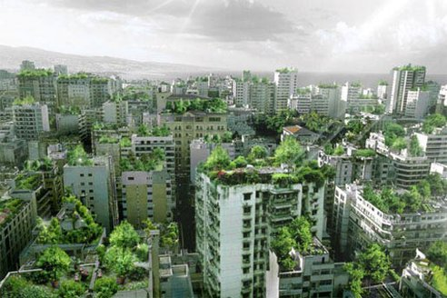
The End

