Slide 1
Development vs. Environment
Sustainable Urbanism: An International Perspective
Basheer Alshammari
Kyle Morris
Toritseju Omaghomi

Slide 2
OUTLINE
Development
Types of development and how it is measured
Features of development-Urbanization
Effects of urbanization on the environment
Examples of effects
Balancing the scales and learning from experience
Benefits of learning
What we hope to learn

Slide 3
Development is a state of growth or advancement
Economic growth is the increase in total value of goods and services produced.
Measured in Gross Domestic Product (GDP), Gross National Product (GNP), per capita income etc.
Top 5 GDP in the world
United States, China, Japan , Germany, France
Development is an improvement in human welfare, quality of life,
social wellbeing by satisfying the populations needs and wants
Measure by socio-economic indicators (population growth, education,
employment, housing and amenities, economic indices etc.)
Sustainable development is the type of development that addresses the populations present need without jeopardizing the ability of the future generations to meets its own need.
Measured using indicators of environmental quality (air quality, water quality, amount of waste generated etc.)
Lessen adverse impact on environment
Conservation of nonrenewable resources
Lower carbon footprint
Notes:
GDP
GNP
PPP
Per capita

Slide 4
Benefits of Economic Development

Slide 5
Effects of urbanization on the environment
Air – Increased Temperature
Land – Increased Runoff

Slide 6
Effects of urbanization on the environment
Water –Increased water pollution

Slide 7
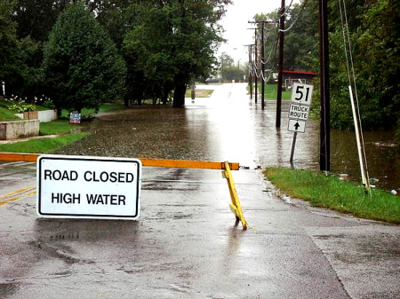
Effects of urbanization on the environment
Water –Flooding

Slide 8
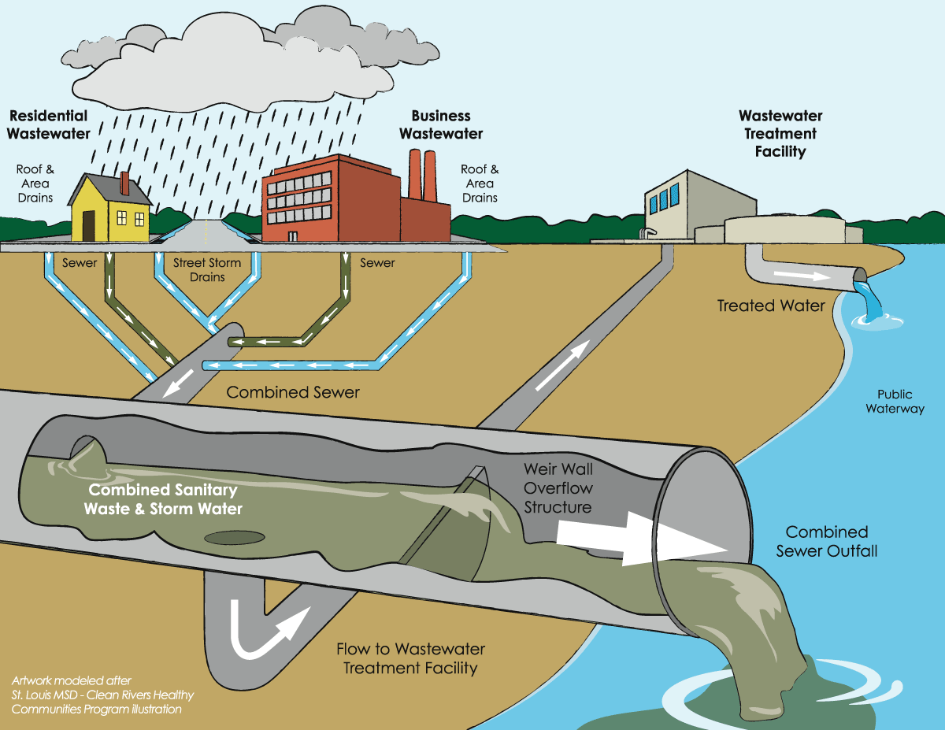
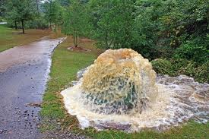
Effects of urbanization on the environment
Water –Sewer Overflow

Slide 9
Examples of the effects of urbanization
Some effects are not caused by urbanization. However, because of urbanization, the number of people at risk increases.
Port cities with a population of over 1 million have the highest population exposure to flood.
Other natural hazard such as earthquake, fire outbreak, even health hazards

Slide 10
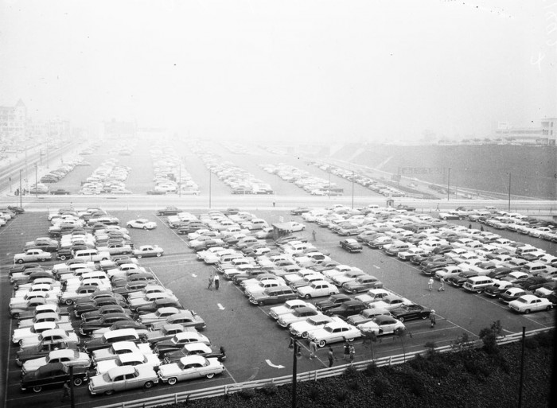
Examples of the effects of urbanization
London Smog (1952 Winter)
Coal fired induced smog
Respiratory issues (4000 died within 4 days; 8000 within 2 months)
Addressed by building taller chimneys that resulted in trans-border issues :Acid rain
Los Angeles (1955)
Photochemical smog from car exhaust
Affect both plants and human alike
Caused death by respiratory failure
Japan (1956)
Minamata Disease
Toxic chemicals not disposed properly
Led to severe mercury poisoning
http://blog.hemmings.com/index.php/2012/04/18/los-angeles-1955-2/

Slide 11
Examples of the effects of urbanization

Slide 12
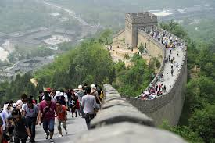
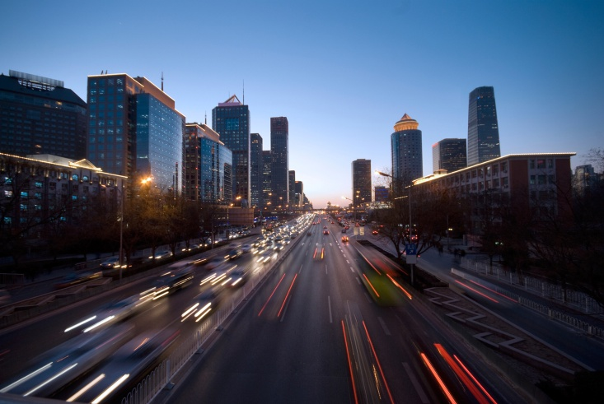
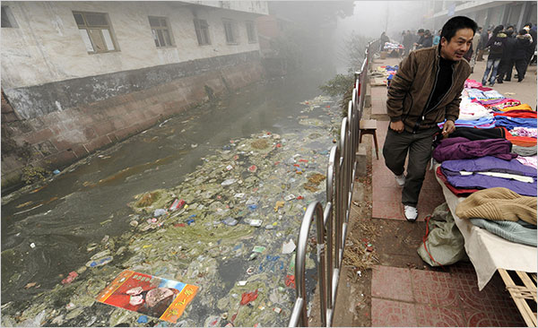
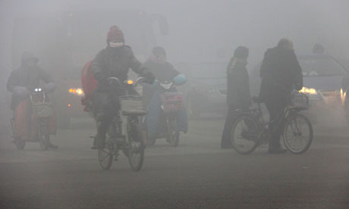
Pros and Cons of Rapid Urbanization
Pros
Growth in industrial productions
Trade and Commerce
Tourism
Technology
Cons
Housing issues
Agriculture
Environment
Water and sanitation treatment
Air quality
Unforeseen issues

Slide 13
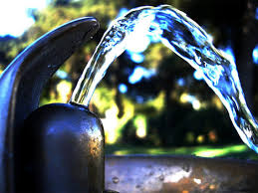
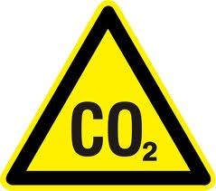
Solutions
Clear Water Infrastructure Sustainability Policy (US)
Clean Air Act (UK)
Energy-saving technology
Development of new energy sources
Circular Economy Promotion Law
Cap & Trade
Carbon/ Emissions tax

Slide 14
Balancing the Scales
DEVELOPEMENT
ENVIRONMENT
“Although beneficial accidents are rare, we can prepare for what they unveil by honing our own skills and learning from others experience.”
Unknown quotes

Slide 15
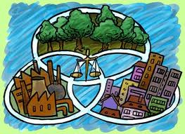
Resolutions
Adoption of strict water policies
Continued state family policies
Practice of sustainable agriculture in rural areas
Encourage research on energy efficient procedures
Reduce carbon emissions by improving carbon capture/sequestration

Slide 16
What we would like to learn
Measures of how to reduce/utilize the runoff from the cities
See some first-hand examples of water management techniques
How past lessons from other countries are impacting future decisions
New environmentally friendly technology being developed

Slide 17
Refereces
http://blog.airdye.com/goodforbusiness/2010/01/25/china-pollution-and-textiles-a-cotton-problem/
http://blog.hemmings.com/index.php/2012/04/18/los-angeles-1955-2/
http://www.ec.gc.ca/eau-water/default.asp?lang=En&n=72FDC156-1
http://www.docstoc.com/docs/48541752/Is-Urbanization-the-Cause-of-Environmental-Degradation
http://www.citiesalliance.org/sites/citiesalliance.org/files/CA_Images/IFRC-WDR2010-full.pdf

