Slide 1
Mapping Out Beijing
Chloe Schaefer

Slide 2
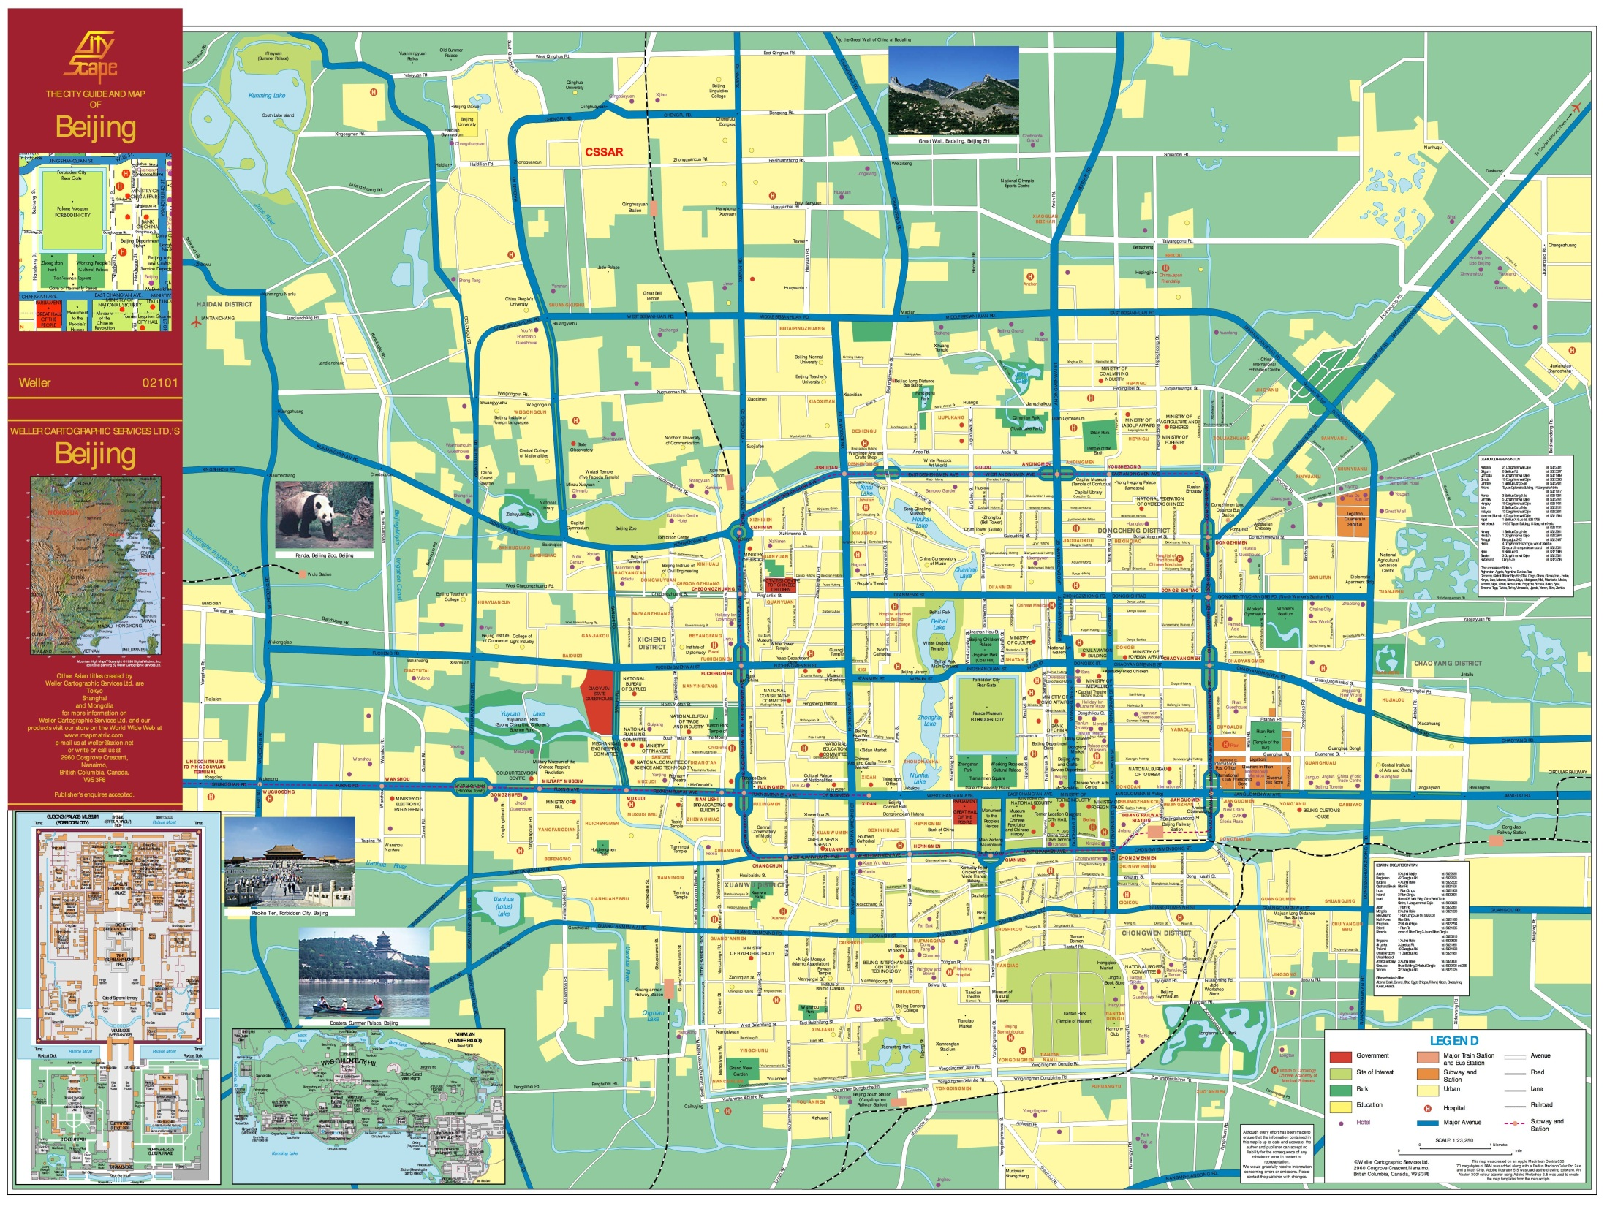

Slide 3
Attributes of Roads in Beijing
City is served by five ring roads. From the center of the city outward they are:
2nd Ring Road
3rd Ring Road
4th Ring Road
5th Ring Road
6th Ring Road
Beijing also has nine toll expressways and eleven China National Highways departing from it that go in all compass directions
Traffic is congestion is widespread due to the five million registered cars in the city

Slide 4
Public Transportation
Subway
Finished in 1969
Has 14 lines, 198 stations and 336 km of track in operation
Fare is 2 RMB (approx. $0.32)
Children under 120cm ride free
If you have extra luggage, you must purchase an extra ticket as baggage fee
Rush hours: 7am-9am and 5pm-7:30pm; taxi suggested
Busses
There are over 800 bus routes in operation
Operate from 5:30am to 11pm
Fare is 1 RMB
Numbers indicate which part of town they operate in
1-100: busses within 3rd Ring Road
101-118, 124: trolleys in 2nd Ring Road
300-810: busses from downtown to suburban Beijing
900-998: Long Distance busses (e.g. downtown to Great Wall)

Slide 5
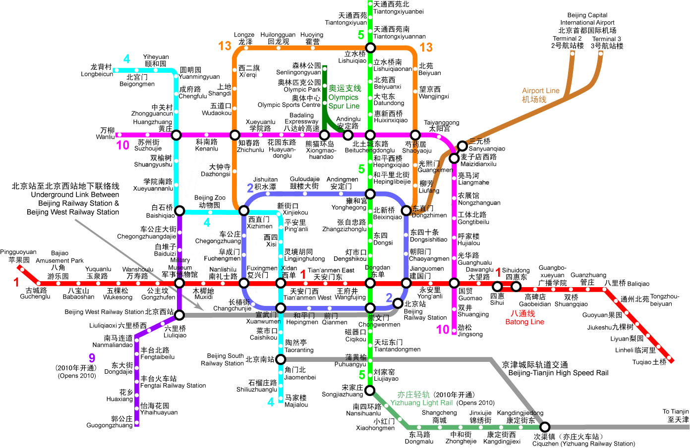
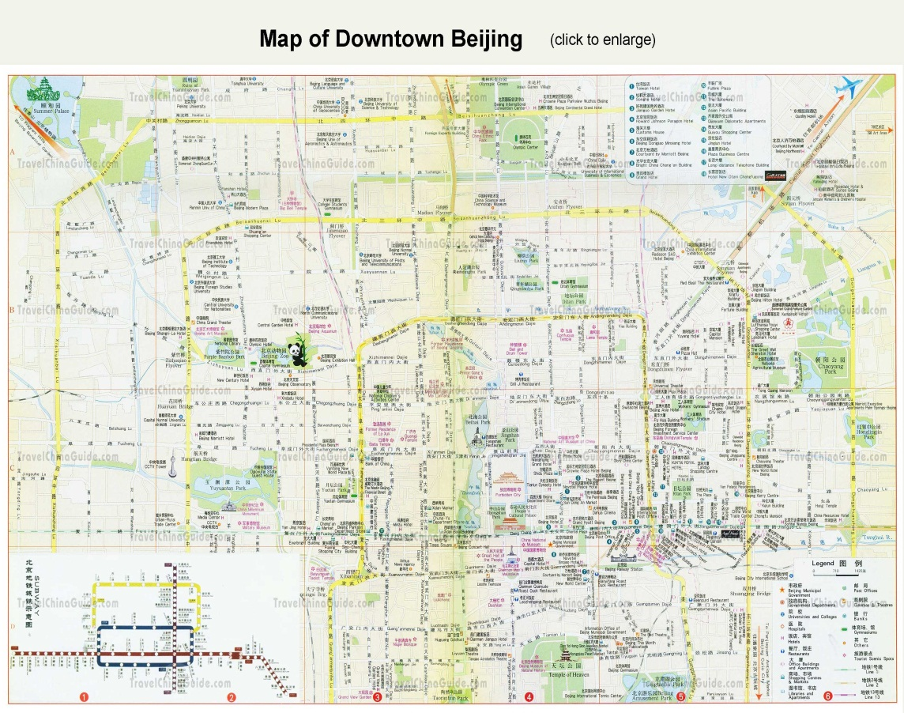
Public Transportation
Subway Map
Bus Map

Slide 6
Public Transportation (con’t.)
Taxis
Most convenient way for travelers to get around the city
2 RMB surcharge for fuel if journey is over 3km
Daytime fare: 10 RMB for first 3km, 2 RMB/km for the remainder of journey
If longer than 15km, 3 RMB per km after 15 km
Nighttime fare (after 11pm): 11 RMB for 3km, 2.4 RMB/km for remainder of journey
If longer than 15km, 3.4 RMB/km after 15km
Waiting and stationary time is charged 1km fare for every 5 minutes
So if you wanted to travel 17 km after 11pm it would cost approximately 17.8 RMB or $2.86

Slide 7
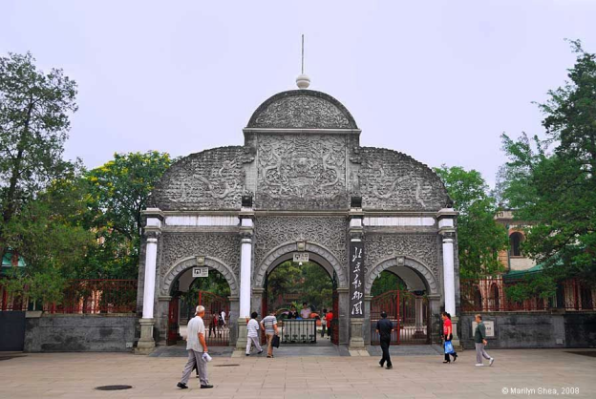
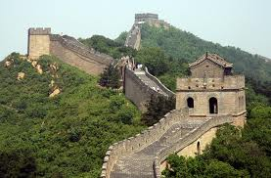
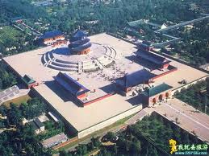
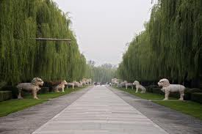
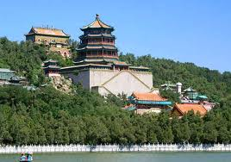
Places to see in Beijing
Beijing Zoo
Tiananmen Square
The Forbidden City
The Great Wall
The Temple of Heaven
Summer Palace
Ming Tombs

Slide 8
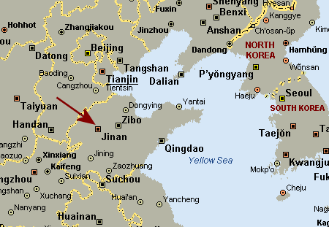
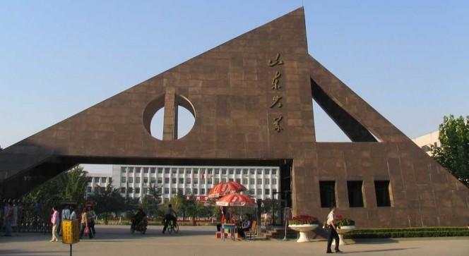
Jinan
Approximately five hours from Beijing
Large province, not as crowded as Beijing
Home to Shandong University

Slide 9
Getting Around Jinan
Public Transportation includes busses and taxis
Busses
2 types: Common bus and K series
Common bus fare: 1 RMB/ticket
K series bus fare: 2 or 3 RMB/ticket
Also have long distance busses that route back to Beijing
Taxis
Fare: 7 RMB for the first 3km, 1.5 RMB/km after the first 3

Slide 10
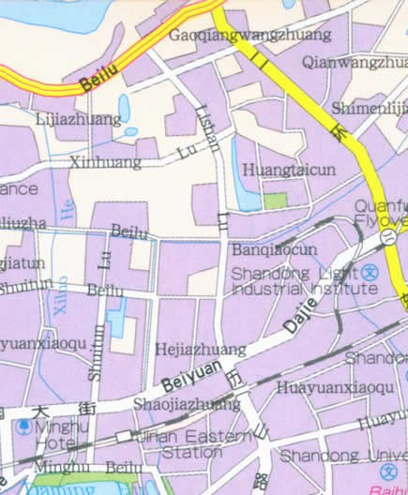
Another Map of Jinan

Slide 11
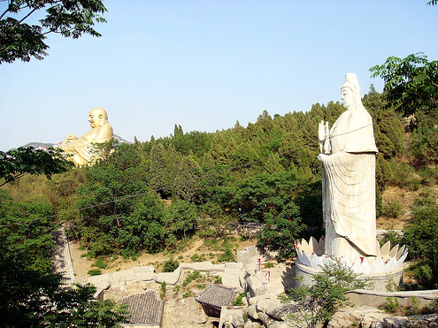
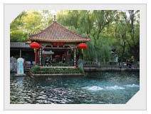
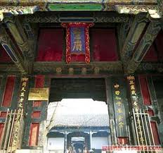
Places to See in Jinan
Shandong University
Baotu Spring Park
Daming Lake Park
Thousand Buddha Mountain
Shandong Provincial Museum
Confucius Temple

Slide 12
Works Cited
Information
http://beijing.etours.cn/top_10_must_see_places_in_beijing/
http://www.explorebj.com/subway/
http://www.travelchinaguide.com/attraction/shandong/jinan/
http://www.chinatouronline.com/china-travel/jinan/jinan-transportation/index.html
Pictures
www.beijingcentre.com
iammodernman.wordpress.com
en.paralympic.beijing2008.cn
www.full-stop.net
hua.umf.maine.edu
www.sinowaytravel.com
www.chinatourmap.com
www.travelchinaplanner.com

